Slide 1
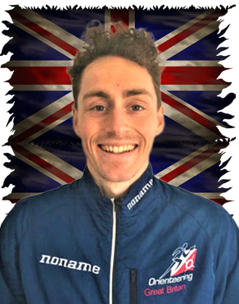
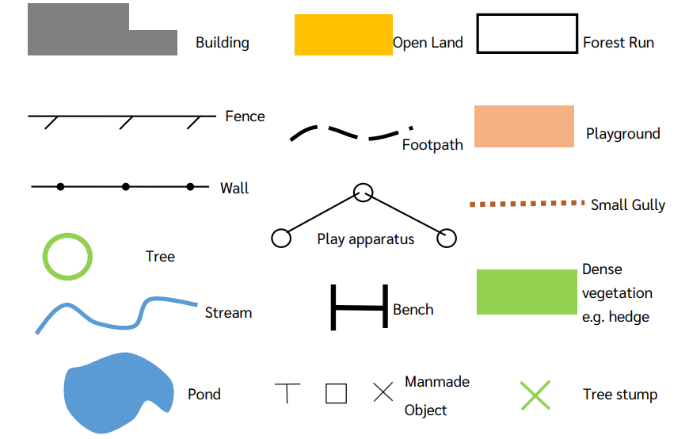
Shirley Heath Orienteering (OAA): Year 3
Skills
1 | Reading Maps | Use a map to identify certain areas of a place.
2 | Using symbols | Know what symbols indicates a certain building / object.
3 | Teamwork | Working together as a team to achieve a goal.
4 | Trust-based activities | Rely (safely) on team-mates to help you achieve a goal as a team.
Vocabulary
1 | Map | A representation of an area of land
2 | Route | A way or course taken in getting from a starting point to a destination.
3 | Trust | belief in the reliability, truth, or ability of someone
4 | Scale | On a map, how much smaller a pictorial representation is, compared to the real-life equivalent.
5 | Lead | Be a route or means of access to a particular place or in a particular direction.
6 | Follow | To go to a certain place (may be influenced by somebody else).
7 | Plan | an intention or decision about what one is going to do.
8 | Control | To influence a certain movement, direction or event.
9 | Problem-Solving | The process of finding solutions to difficult or complex issues.
Peter Bray:
Bray is a British Orienteering champion who has competed nine global events in his career. He lives in Manchester and couples his orienteering with his job as an Environmental Consultant.

