Slide 1
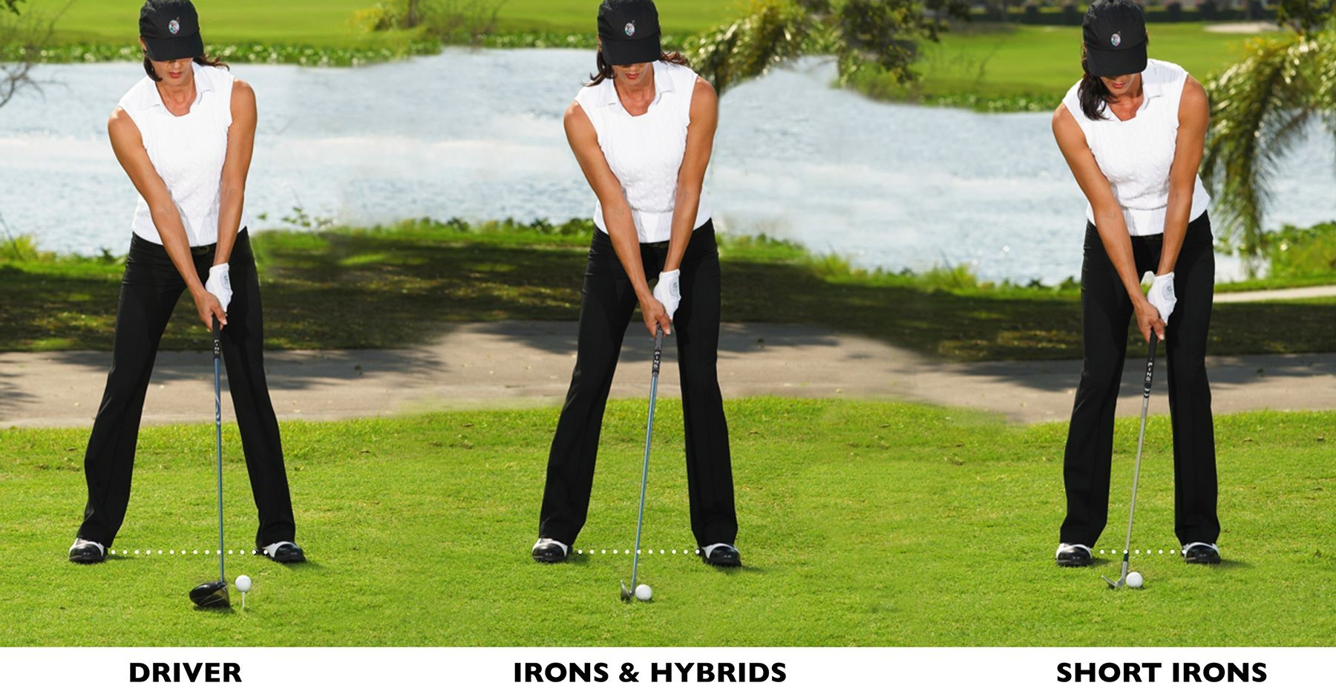
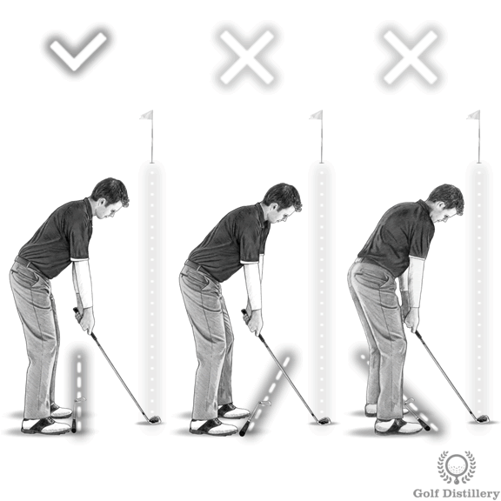
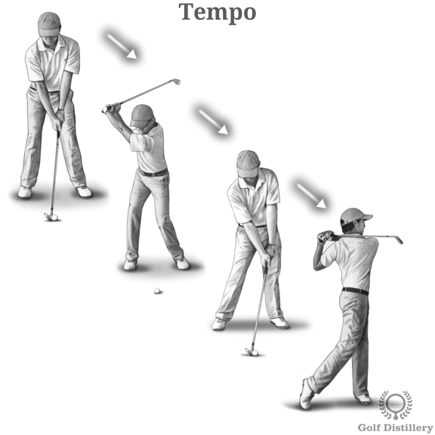
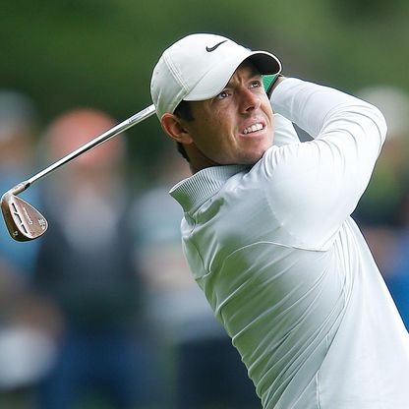
Shirley Heath Year 3, Summer 2: Golf
Skills
1 | Grip | Hold the club with your hands Interlocking, and overlapping each other.
2 | Stance | To incorporate a good stance, start with feet shoulder-width apart, a slight bend in the knees, hips raised and your left shoulder angled above the right. Swing will follow after you have the grip and stance down pat.
3 | Swing | Your body should be like a pendulum. You should practise 2 or 3 times before hitting the ball. The types of shot you might play are: Drive shot, iron shot, pitch shot, chip shot, putt
4 | Slice | A slice refers to curving the ball in the direction of the player's dominant hand
5 | Hook | a hook refers to curving the ball in the direction opposite the player's dominant hand
Vocabulary
1 | Strike | Hitting the golf club in an attempt to get the baller closer to, or into, the hole.
2 | Putt | Attempting to hit the golf ball into the hole.
3 | Drive | Hitting the ball the furthest possible distance.
4 | Club | The golfing term of the item you use to hit the ball.
5 | Woods | Used to send the golf ball the furthest
6 | Irons | Used when the ball is within 200 yards of the green
7 | Wedges | Used to send a ball up into the air, soaring onto the putting area.
8 | Putters | Used when you need to roll your ball around the green and into the hole.
Golf Stances: Moving into a Putt:
Incorporating the grip, stance and swing (and post-shot routine).
Rory Mcllroy MBE:
Rory McIlroy MBE is a professional golfer from Northern Ireland who is a member of both the European and PGA Tours. He is the current world number one in the Official World Golf Ranking, having spent over 100 weeks in that position during his career.

