Slide 1
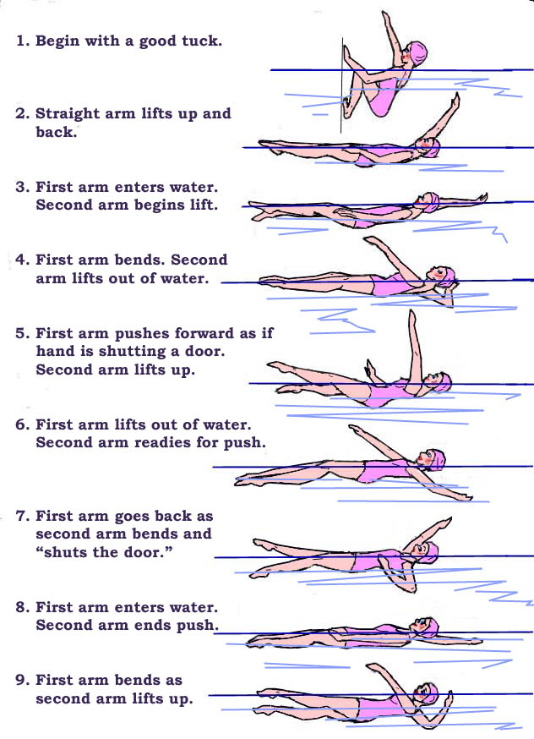
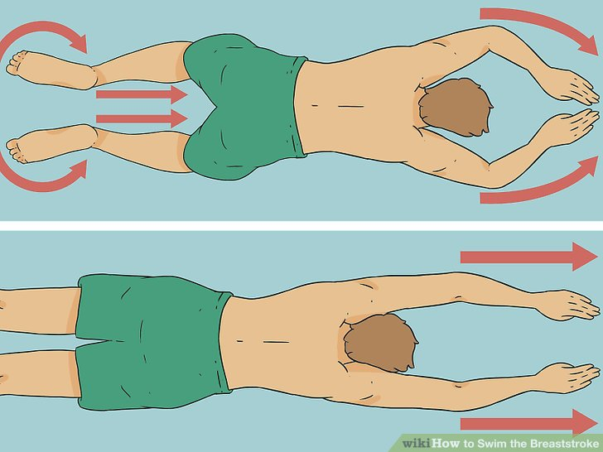
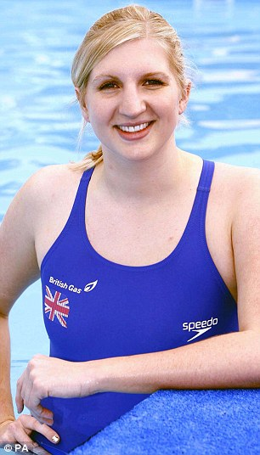
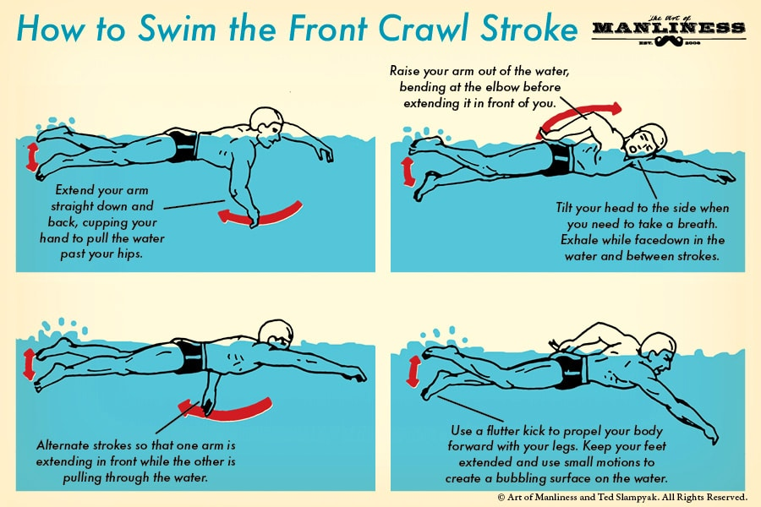
Shirley Heath Year 4, Summer 1 & 2: Swimming (at Tudor Grange)
Skills and Vocabulary
1 | Swim | Move your body through water by using arms / legs
2 | Kick | Move your legs up and down / rotate to propel your body through the water.
3 | Float | To move on the water without being sunk / submerged
4 | Sculling | Propel your body by lying on your back making small movements with your arms.
5 | Front Crawl | Moving your arms over your head whilst also kicking your feet
6 | Backstroke | On your back, your arms lifted alternately out of the water in a backward circular motion and the legs extended and kicking.
7 | Breastroke | Your arms are pushed forwards and then swept back in a circular movement, while the legs are tucked in towards the body and then kicked out
8 | Dive | plunge your head first into water with your arms raised over your head.
Backstroke Breast Stroke
Pushing arms and legs out. Then, glide through the water being as straight as possible.
Front Crawl:
Rebecca Adlington OBE:
Adlington is a British former competitive swimmer who specialised in freestyle events in international competition. She won two gold medals at the 2008 Summer Olympics in the 400-metre freestyle and 800-metre freestyle. Adlington was Britain's first Olympic swimming champion since 1988, and the first British swimmer to win two Olympic gold medals since 1908. She won bronze medals in both the women's 400-metre and 800-metre freestyle events in the 2012 Summer Olympics in London.

