Slide 1
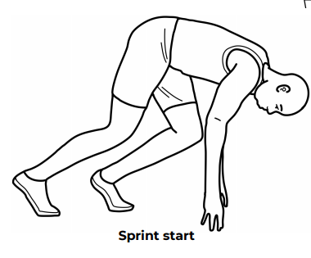
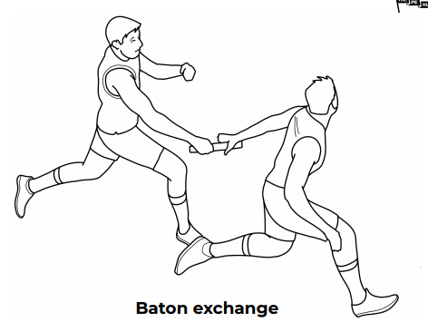
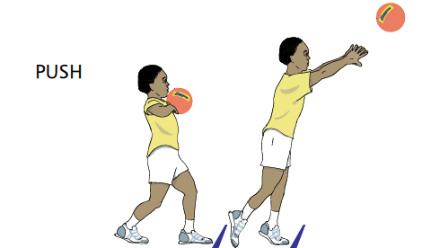
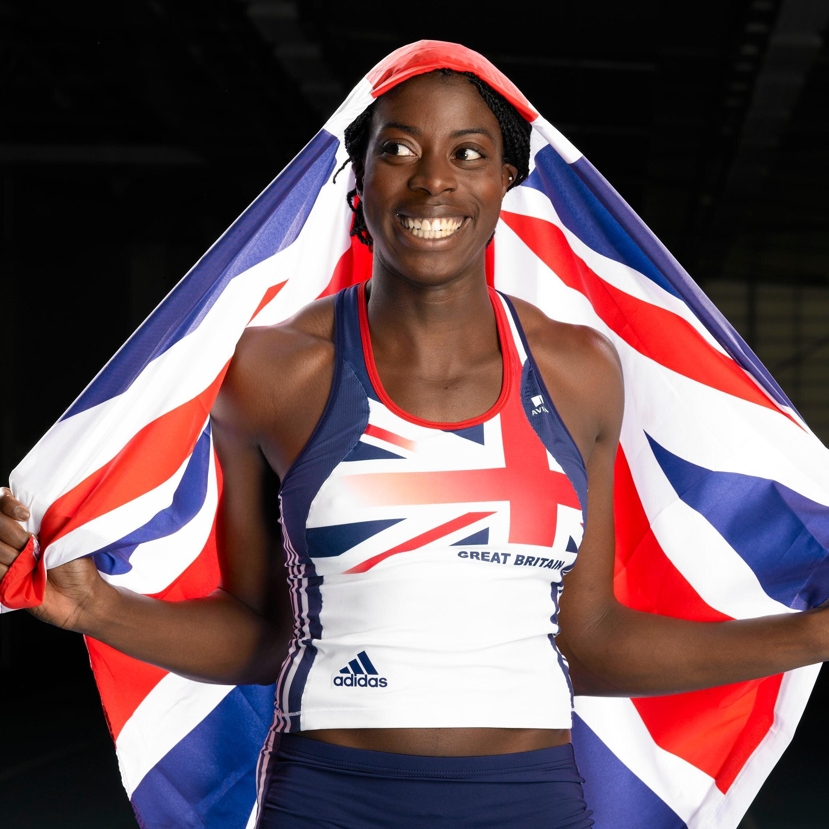
Shirley Heath Year 5, Summer 1: Athletics
Vocabulary
1 | Throw | Propel (something) with force through the air by a movement of the arm and hand.
2 | Agility | Ability to move quickly and easily.
3 | Distance | the length of the space between two points.
4 | Baton | a short stick or tube passed from runner to runner in a relay race.
5 | Accelerate | increase in speed or rate.
6 | Relay | A group of people participating in a race
7 | Jump | push yourself off a surface and into the air by using the muscles in one's legs and feet.
Skills
1 | Running Individual amount less than 600m | An action to move quickly with the correct technique using arms and legs as effectively as possible.
2 | Jumping | The technique to propel the body into the air to cover distance, height or both.
3 | Throwing | The ability to propel the an object through the air as fast, and as far, as possible.
4 | Relay Working to develop a pace | Running with other people to cover a certain distance.
Starting a sprint / relay →
Baton exchanging for relay:
Push Throw:
Christine Ohuruogu MBE:
Christine Ijeoma Ohuruogu, MBE is a British track and field athlete who specialises in the 400 metres, the event for which she is a former Olympic, World and Commonwealth champion.

