Slide 1
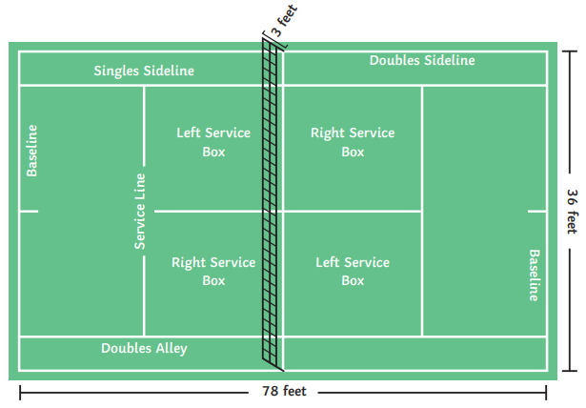
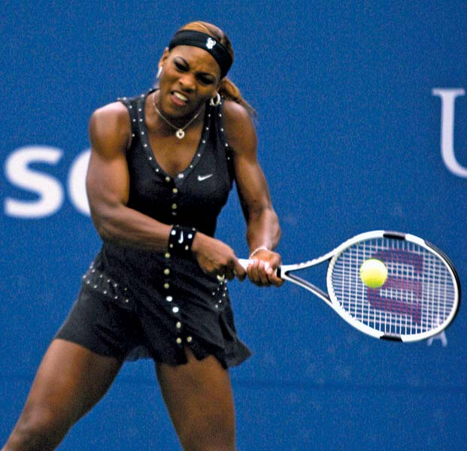
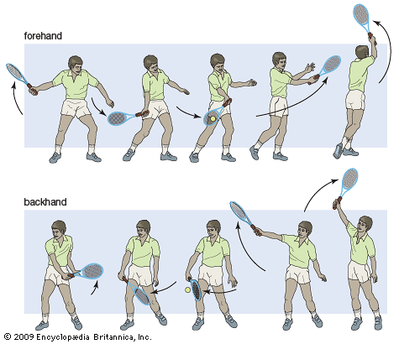
Shirley Heath Year 5, Summer 2: Tennis
Skills
1 | Different shots (forehand, backhand, underarm serve) | to play a forehand, we move our arm horizontally towards our body; to play a backhand, we move our arm horizontally away from our body; to play an underarm serve, we flick our racket horizontally up whilst bouncing a ball.
2 | Volley | To play a volley shot, we hold the racket in front of our body, not letting the ball bounce, and flick our wrist.
3 | Overhead shot | To play an overhead shot, we hold our racket vertically above our head, hitting the ball at the highest point.
4 | Playing Doubles | We use front and back positioning when attacking, and side to side positioning when defending.
5 | Preventing a Second Bounce | To prevent a second bounce, ensure that you are standing on the balls of your feet and watch and anticipate where the ball is going to land.
Vocabulary
1 | Forehand | Hitting with front of racket
2 | Backhand | Hitting with back of racket
3 | Underarm | Lowering the racket, then rising to hit the ball
4 | Overarm | Smashing, with pace, the ball on the way down.
5 | Volley | Hitting the ball without it bouncing first
6 | Doubles | Two players playing against another two players
7 | Singles | One player playing against one other player
8 | Return | To hit the ball back to your opponent.
Serena Williams:
Forehand & Backhand technique:
Williams is an American professional tennis player and former world No. 1. She has won 23 major singles titles, the most by any man or woman in the Open Era.

