Slide 1
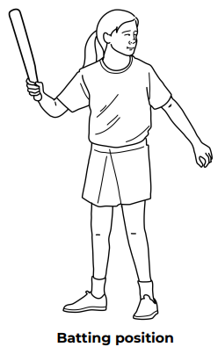
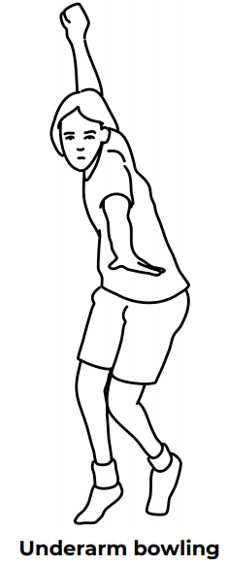
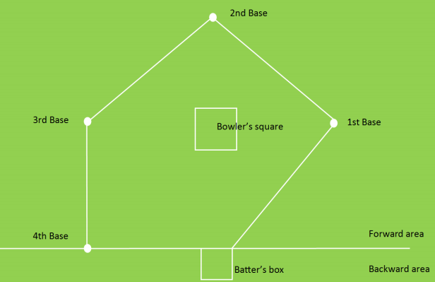
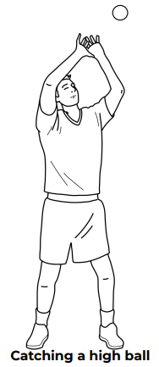
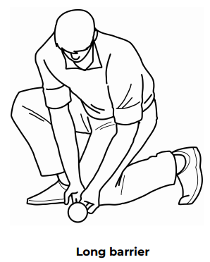
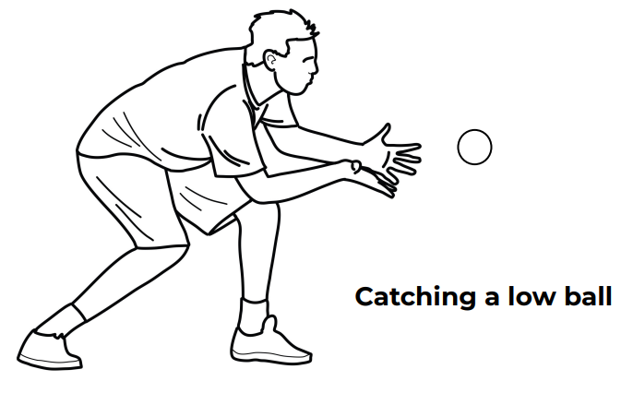

Shirley Heath Year 6, Summer 1: Rounders
Skills
1 | Batting Positon | Standing side on with your dominant (and batting hand behind you) ready to swing at the ball once it has been bowled.
2 | Bowl | Step with the opposite foot to throwing arm; Swing throwing arm from back to front; End throwing arm aiming at the target/ To increase speed have a quicker backswing/faster swing, but still, remember all of the techniques.
3 | Stumping | Retrieving the ball as a fielder and hitting the stumps with the ball or with your body (with the ball under your control).
4 | Hitting / Striking | Hitting the ball when bowled by aiming at the lower quarter of the ball (at a 45 degree angle). This will produce the most height / distance.
5 | Catching | Make sure you are standing underneath the ball with ready hands (see Catching Techniques below). Then, keep your eyes on the ball. Spread hands and bring to your chest once caught.
Vocabulary
1 | Stance | Standing in the correct way to bowl, bat or field the ball
2 | Batsman | The player who is hitting the ball and attempting to run around the posts to score points.
3 | Fielder | A player who is attempting to get the opposition out by catching the ball or stumping at a post.
4 | Backstop | A fielder who stands behind the batsman to catch the ball if it is missed/ sliced / thin edged by the batter.
5 | Innings | When you change from batting to fielding or vice-versa
6 | Strike | Hitting the ball with the bat.
7 | Rounder / Half-rounder | By running around all four bases after hitting the ball (1 rounder). Getting to base two (half rounder).
Setting up a rounders pitch:
Catching techniques:
← Fielding when the ball is travelling on the ground.
Emily Lenton:
Emily Lenton is the current England Rounders captain. She has played rounders for England since she was 14 years old.

