Slide 1
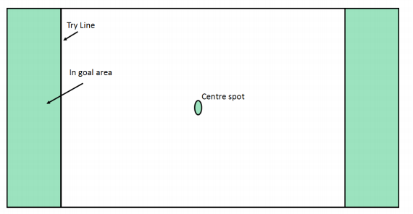
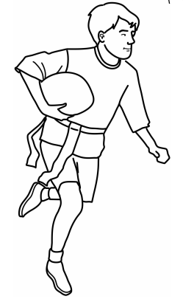
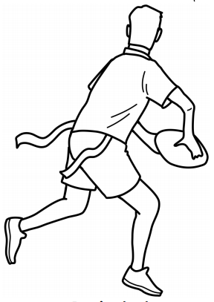
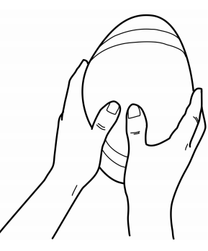
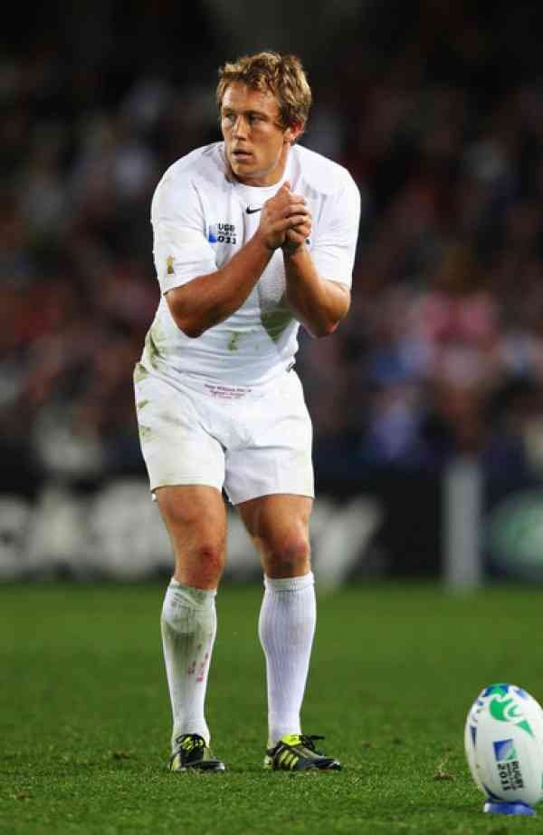
Shirley Heath Year 6, Summer 2: Tag Rugby (Edwardians RFC)
Skills
1 | Passing | Hold ball in front of body in two hands with fingers spread on either side. To pass left– right hand for power (towards back of the ball) and left for aim (towards front of the ball). ... For a pass to the left, your right hand runs up and along the ball.
2 | Running | Moving quickly, using your legs to power you.
3 | Tag | Taking a tag from an opposition belt (the same as a tackle in conventional rugby)
4 | Teamwork | Working together to achieve a try.
5 | Defend | Preventing the opposition from scoring a try (or any points).
Vocabulary
1 | Possession | A team having control of the ball
2 | Try-Area | The opposition end in which you can score points from.
3 | Pressure | Forcing your opposition into moving the ball quickly or losing possession.
4 | Space | An area of the pitch where there is no opposition.
5 | Belt | An object worn around the waist containing tags (something the opposition want to steal)
Try Line
In Goal Area
Centre Spot
Tag Rugby Pitch
Jonny Wilkinson CBE:
Wilkinson is an English former rugby union player. A fly-half, he played for Newcastle Falcons and Toulon and represented England and the British and Irish Lions. He is particularly known for scoring the winning drop goal in the 2003 Rugby World Cup Final.
Running with the ball
Passing Back
‘W’ Grip

