Slide 1

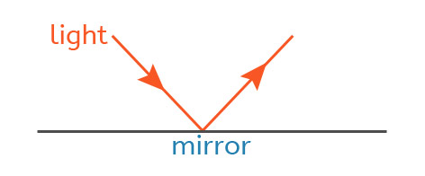
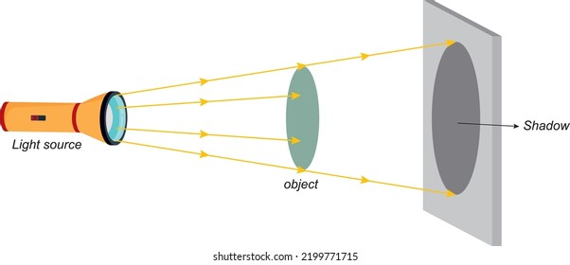
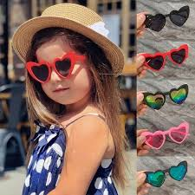
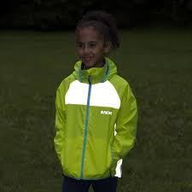
Shirley Heath Light (Physics) | Year 3 | Summer 1
Key Knowledge
1 | A light source is something that produces its own light (like the sun).
2 | Some materials are very good at reflecting light.
3 | The sun can harm our eyes so we need to protect them.
4 | Shadows are caused by an object blocking the light from the sun.
5 | Some materials block light fully but other materials only block some of the light.
6 | The smaller the distance between the light source and the object, the bigger the object's shadow is.
Key Diagrams
Key Vocabulary
Light source | Where the light is being produced
Reflector | Something that light bounces off as it travels in straight lines
Shadow | Where light cannot reach
Opaque | Light cannot pass through
Transparent | Light can pass through
Translucent | Light can partially pass through
This is how light reflects from a surface

