Slide 1
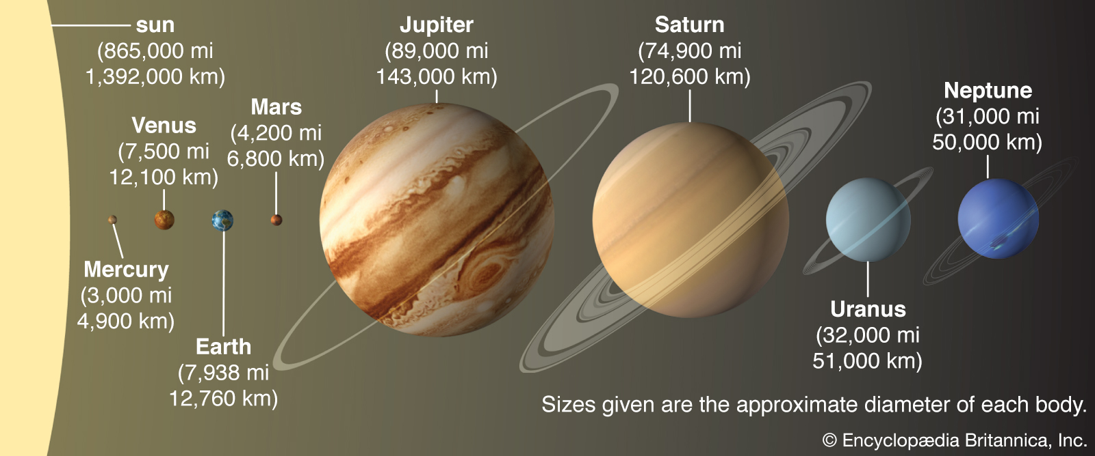
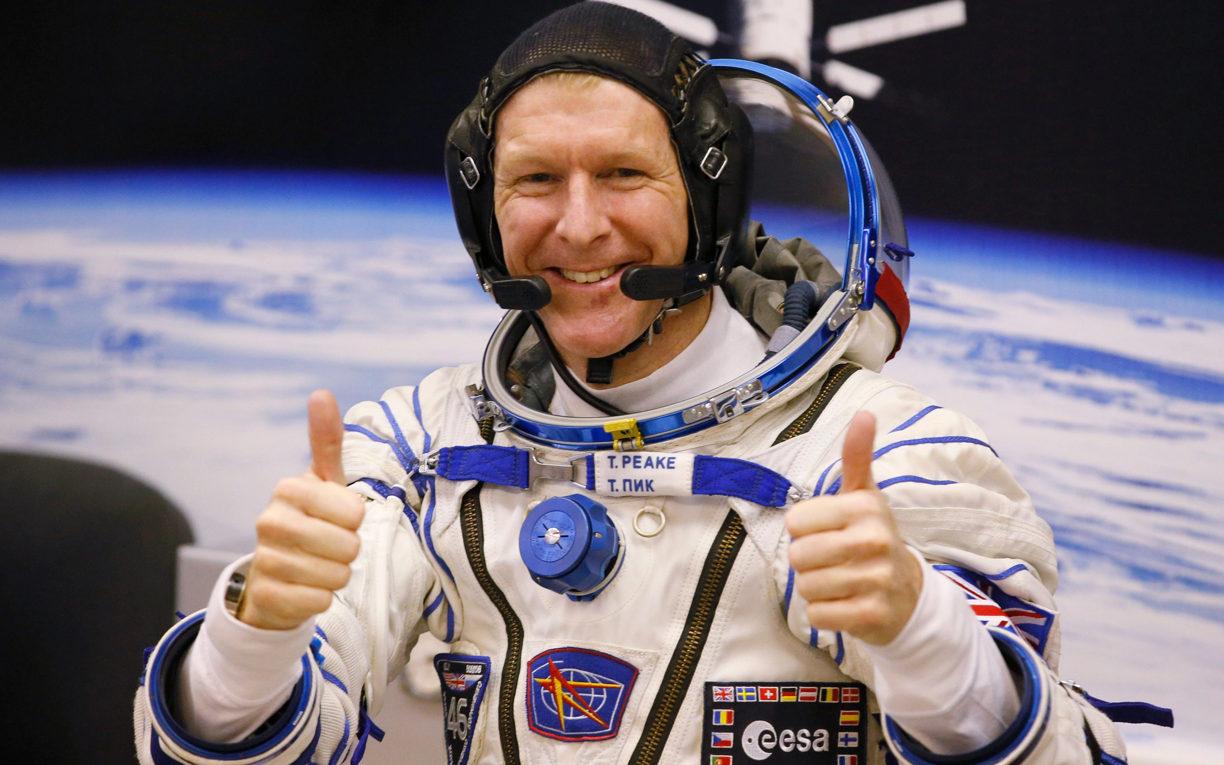
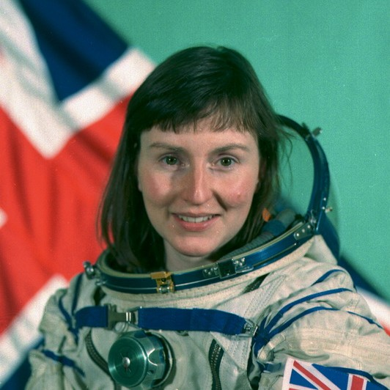
Shirley Heath Earth and Space (Physics)| Year 5 | Summer 1
Key Knowledge
1 | The History of Astronomy The three figures are Ptolemy, Galileo and Copernicus
2 | Geocentric view- an early (incorrect) theory that all of the planets orbited the Earth Heliocentric view – the correct view that the planets orbit the Sun.
2 | The Solar System The order of the planets: Mercury, Venus, Earth, Mars, Jupiter, Saturn, Uranus, Neptune
3 | Objects in space Objects like stars, planets and moons are spherical because gravity acts in all directions equally. The earth rotates (24 hours) and revolves (orbit 365.25 days)
4 | Day and Night When the side of the Earth that is facing the Sun is experiencing daytime, the side of the Earth that is facing away from the Sun is experiencing night-time. The rotation of the Earth is what causes day and night.
5 | The Moon The Moon takes 28 days to orbit the Earth. A new Moon is when the side of the Moon facing the Earth is not lit. There is a new Moon every 28 days (1 month)
6 | The Seasons When the northern hemisphere of the Earth is tilted away from the Sun, people in the these regions are experiencing Winter. When the northern hemisphere of the Earth is tilted toward the Sun, people in these regions are experiencing Summer
Key Diagrams
Important Scientists
1 | Major Tim Peake (1972- The first ESA astronaut to visit the International Space Station
2 | Helen Sharman (1963- A chemist who became the first British astronaut to visit the Mir Space Station in 1991
Key Vocabulary
Revolution | The Earth revolves around the Sun following an elliptical path
Rotation | The Earth has an imaginary axis running from the North to South pole on which is rotates
Tilt | The axis of the Earth is titled at 23.5 degrees (This is why we get different seasons)
Waxing | Means that we can see more of the moon
Waning | Means that we can see less of the moon

