Slide 1
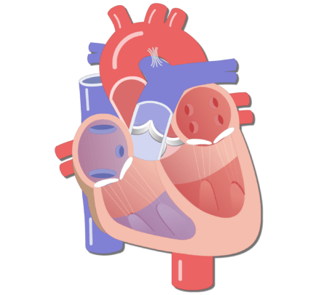
Shirley Heath Diet, Circulation and Exercise (Human Biology)| Year 6 | Summer 1
Key Knowledge
1 | Blood consists of 4 main parts: plasma; red blood cells; white blood cells; platelets
2 | Blood is a liquid that carries oxygen, water and nutrients around the body
3 | The heart pumps blood to the lungs to collect oxygen and then to the rest of the body
4 | Blood moves through arteries, veins and capillaries.
5 | The body uses oxygen to make energy to survive and produces carbon dioxide as a waste product.
6 | Drugs, alcohol and smoking can have negative effects on the body.
7 | a balanced diet involves eating the right types of nutrients in the right amounts.
Key Diagrams
Key Vocabulary
The heart | An organ that pumps blood around the body
Circulatory system | the system of the heart, blood and blood vessels that transports substances around the body
Blood vessels | tube-like structures that carry blood around the body
Arteries | Carry oxygenated blood away from the heart. In the arteries, blood is a deep red colour as it is rich in oxygen.
Veins | Carry deoxygenated blood toward the heart
Capillaries | Narrow blood vessels that deliver oxygen, water and nutrients and remove carbon dioxide from every area of the body
plasma | The liquid part of blood
White blood cells | Fight infection
Red blood cells | Transport oxygen (and carbon dioxide)
platelets | Repair cuts by making blood clot
Left side
Right side
Important Scientists
1
2

