Slide 1
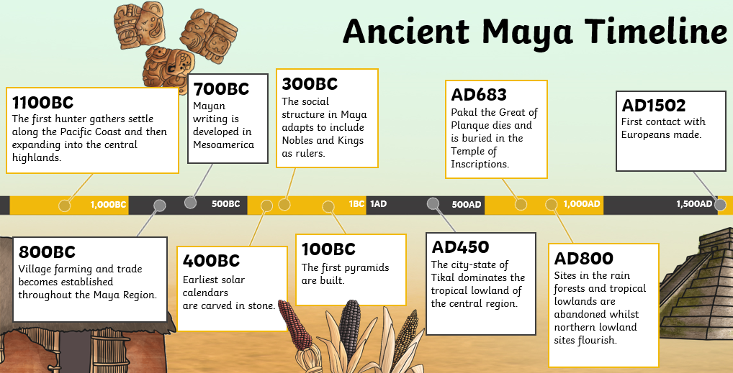
Shirley Heath Mayans | Year 6 | Summer
Who were the Mayans?
Developed a sophisticated culture of city states with monumental buildings and characteristic stepped pyramids.
Lived in great cities (e.g. Yax Mutal and Palenque) and farmland. They were great farmers.
End of the Empire
There are numerous theories as to why the ancient Mayan civilisation came to an end, as no-one knows for sure.
Drought
War
Deforestation
Vocabulary
Mayans | The Maya civilisation began long ago in a place called 'Mesoamerica'. This huge area is made up of Mexico and part of Central America. Lived in central America around 4000 years ago (2000 BC). They lived in different cities, ruled by different kings and queens.
Yax Mutal | Now known as Tikal, it is complex of Mayan ruins deep in the rainforests of northern Guatemala. Yax Mutal was the capital city of the Mayan empire.
Palenque | Palenque is one of the most studied and documented Mayan archeological ruins.
Drought | Drought is a continuous period of dry weather, when an area gets less than its normal amount of rain, over months or even years
Deforestation | The clearing, or cutting down, of forests.
Artefacts
Mayan pyramids
Sculptures
Art
Ceramic pots
Jewellery
Mayan beliefs
They believed in many gods, who they worshiped every day. Believed their rulers could communicate with gods and ancestors.
Itzamna - The most important Maya god, ruler of heaven as well as day and night.
Kukulkan – A powerful snake god
Bolon Tzacab - The god of storms, wind, and fire.
Chaac – The god of rain and lightning.
Mayans influence
Calendar
A system of government
Mayan art
Astronomy
Chocolate
Mayan numerical system

