Slide 1
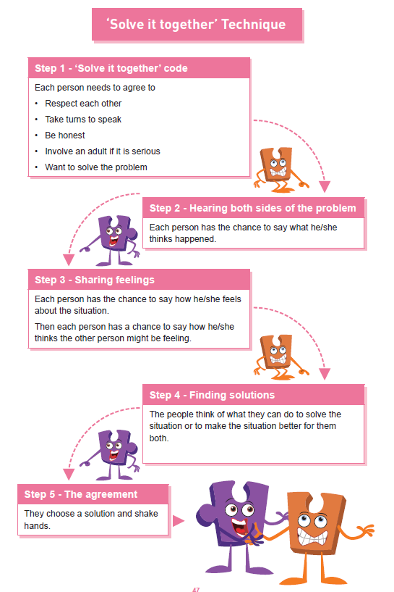
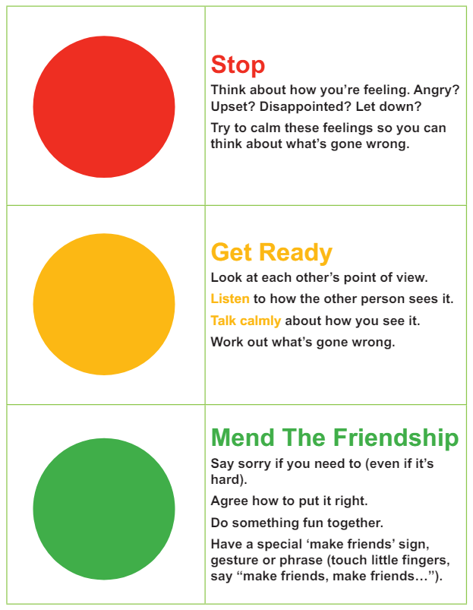
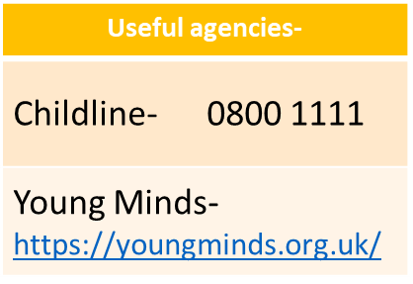
Shirley Heath | Relationships Year Three| Summer 1 P.S.H.E.
The Jigsaw Charter
We take turns to speak
We use kind and positive words
We listen to each other
We have the right to pass
We only use names when giving compliments or making a positive comment
We respect each other’s privacy
Vocabulary
conflict​ | A disagreement or argument.
​equality | Everyone treated the same way- fairly.
global | The whole world.
​imports and exports | Goods coming into our county/good going out of our country.
interconnected | Joined to each other.
negotiate ​ | Have a discussion to solve a problem with a solution that suits everyone.
responsibilities​ | Something that you are required to do eg a task or a job.
solution​ | Solving a problem.
stereotype​ | An idea that people may have about what a certain type of person should look like or act like.
trade | Buying and selling goods.
Knowledge and skills

