Slide 1
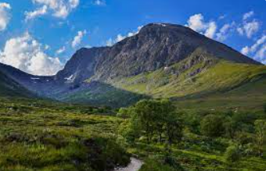
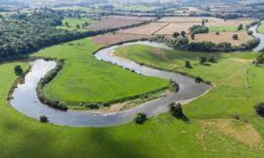
Shirley Heath The United Kingdom | Year 3 | Summer
Coasts
How are coasts formed? | Coasts are formed by erosion
How do we stop erosion? | Sea defences are put up to protect the coasts from erosion.
How are coastlines polluted? | Plastic left on the beach is harmful to the wildlife in our seas
Location
Continent | The UK is in the continent of Europe
Countries | The UK is made up of 4 countries – England, Scotland, Wales and Northern Ireland.
Regions | England is divided up in to 9 regions.
Counties | Regions are divided into counties. The UK is made up of 48 counties.
Cities | The largest cities in the UK are London, Manchester and Birmingham.
Vocabulary
Biome | An area sharing similar vegetation (plants) and climate.
Temperate climate | Four seasons – spring, summer, autumn and winter. Mild temperatures and moderate rainfall.
Deciduous forest | Tress that lose their leaves at the end of a growing season.
Tourism | when people travel from where they live to another place for pleasure.
Coast | Where land and sea meet.
Erosion | The wearing away of the land by forces such as water, wind, and ice.
Trade | The exchange of goods and services between one country and another.
Landmarks | Features or structures around the world that are easily recognised.
Renewable energy | Energy from resources that nature will replace, like wind, water and sunshine
Non-renewable energy | Energy that comes from burning fossil fuels. We will soon run out of them.
Landmarks
The UK attracts many tourists who visit our landmarks
Examples of Human Landmarks | Buckingham Palace, Angel of the North, Forth Bridge
Examples of Physical Landmarks | Stonehenge, Giant’s Causeway, White Cliffs of Dover
Ben Nevis in Scotland is the tallest mountain in the UK
Countryside
Land use | Much of out countryside is made up of farmland.
What is a National Park? | National Parks like the Lake District are protected areas for people to enjoy walking and cycling.
The River Severn is the longest river in the UK. It flows through Wales and England..
Energy
Wind Farms | Wind farms produce are a renewable source of energy. They are best situated on high ground or on the coast where the wind is stronger.
Climate Change | Burning fossil fuels causes global warming when the planet gets hotter..
UK Trade Links
Exports | Many items farmed or made in the UK is exported to other countries.
Top exported items | Fish, cheese, meat, cars, aircraft parts, medicines

