Slide 1
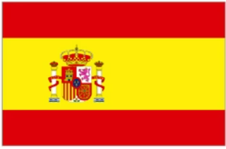
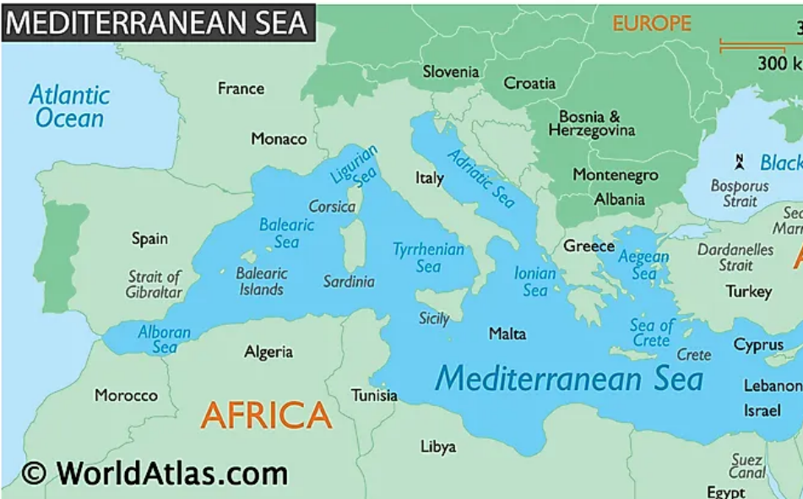
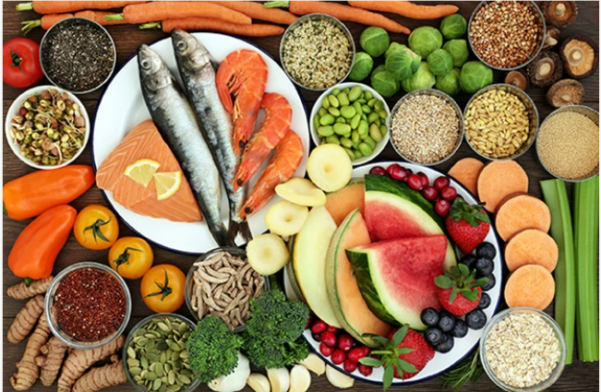
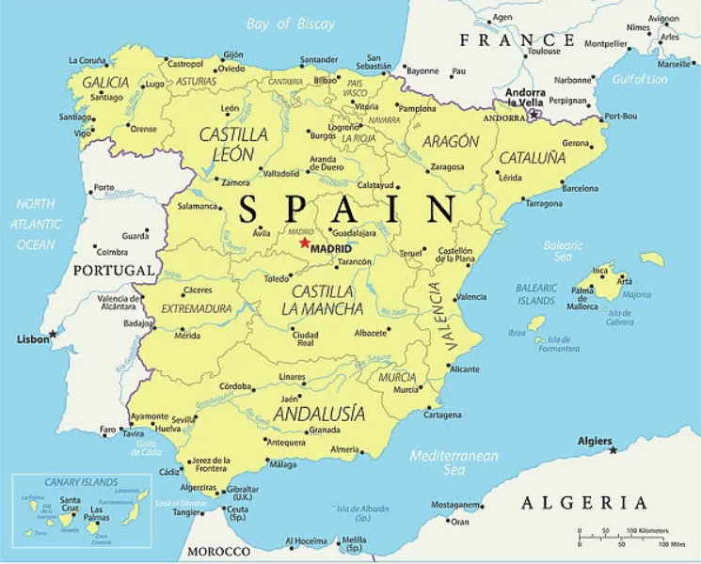
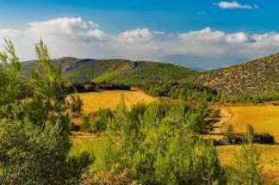
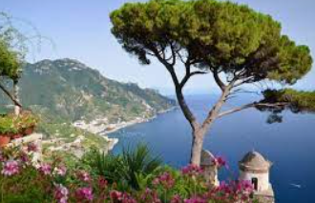
SHIRLEY HEATH SPECTACULAR SPAIN YEAR 4 | SUMMER
SPAIN
Location | Spain is a country located in south-western part of Europe
Surrounding countries | It shares borders with Portugal to the west and France to the northeast, its southern and eastern coasts are by the Mediterranean Sea.
Capital city | The capital city of Spain is Madrid.
Tourism | People visit Spain for its beautiful beaches, rich history, vibrant culture, delicious food, and sunny weather.
Language spoken | Spanish
Biomes | Spain lies within the savannah biome
Climate | Spain has 5 different climate zones. It has a very warm summer and mild winter. It is warmer than the UK because it is closer to the equator.
Mountains | The Pyrenees, The Sierra Nevada, The Cordillera Cantabria
VOCABULARY
Coast | Where land and sea meet.
Biome | A biome is a natural area of similar climate, plants and animals.
Vegetation | All plants and trees
Climate | Long-term weather pattern in a region
Physical | Earth's natural features, such as mountains, rivers, deserts and oceans
Human | Built by people such as houses, roads and bridges.
Tourism | When people travel from where they live to another place for pleasure or relaxation.
Trade | The exchange of goods and services between one country and another.
Landmark | An important building or monument
Diet | Food that a person, or community eats.
Locate | Discover the exact place or position of.
THE MEDITERRANEAN
Location | The Mediterranean is a large sea surrounded by countries in Southern Europe, North Africa, and Western Asia.
Main Countries | The countries that surround the Mediterranean Sea include Spain, France, Italy, Croatia, Slovenia, Bosnia and Herzegovina, Montenegro, Albania, Greece.
Biome | Savanna biome
Diet | The climate of the Mediterranean means they can grow lots of colourful fruit and vegetables.
 | A healthy Mediterranean diet is made up of fresh fruit, vegetables and meat.
SAVANNA BIOME
AN AREA OF GRASSLAND WITH DISPERSED TREES OR CLUSTERS OF TREES
Vegetation | Not a lot of grass grows in the Mediterranean. Lots of bushes and scrub land where lavender and rosemary grow.
Climate winter | Mild but rainy. There are some storms and strong winds.
Climate Summer | hot and dry. There is little rain so there are droughts.
FOOD TRADE DISTRIBUTION
Exports (food it sells) | The biggest food exports are: sugar, bananas, coffee, tobacco, beef and corn.
Imports (food it buys) | The biggest food import is wheat.

Slide 2
Fieldwork KO
Compass – to explain position
4 fig grid ref
Tropic of cancer
Tropic of Capricorn
Equator
Climate zone
Arid
Frigid
temperate
climate graph and table

