Slide 1
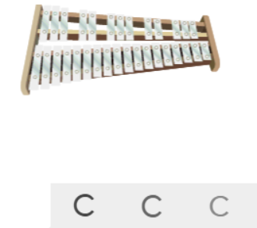
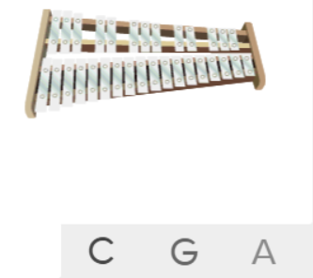
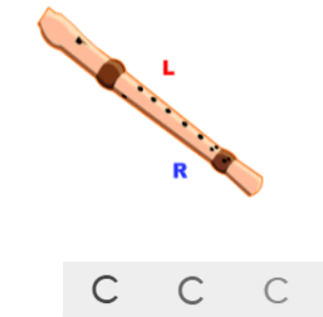
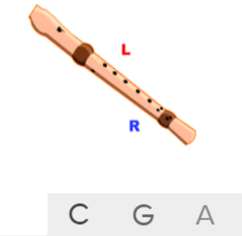
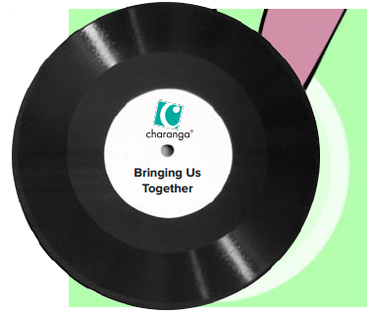
Shirley Heath Bring Us Together| Year 3 | Term: Summer 1
About This Unit
Theme: This is a Disco song about friendship, peace, hope and unity.
Facts/Info: Disco music includes strong drum and bass lines. It has quite a fast tempo with a steady dance groove and energetic electric guitar lines. Disco first appeared in the 1970s in New York.
Listen to 5 other disco songs ‘Good Times’ by Nile Rodgers ‘Ain’t Nobody’ by Chaka Khan ‘We Are Family’ by Sister Sledge ‘Ain’t No Stopping Us Now’ by McFadden and Whitehead ‘Car Wash’ by Rose Royce
Vocabulary
1. | KEYBOARD | A musical keyboard is the set of adjacent depressible levers or keys on a musical instrument.
2. | DRUMS | A drum is a musical instrument that you play by hitting it rhythmically with a stick or your hand.
3. | BASS | The lowest part of the musical scale. It is also a type of guitar which usually has 4-5 strings.
4. | IMAGINATION | Being able to explore music creatively.
5. | Improvise | Playing notes that are not written for you.
6. | Compose | Writing your own music.
7. | DISCO
8. | PENTATONIC SCALE | A musical scale containing five different tones.
9. | Pulse | The regular heartbeat of the music; it’s steady beat.
10. | Rhythm | Long and short sounds or patterns that happen over the pulse.
11. | Pitch | High and low sounds.
12. | Tempo | The speed of the music; fast or slow or in-between.
13. | Dynamics | How loud or quiet the music is.
14. | TEXTURE | How the tempo, melodic, and harmonic materials are combined in a musical composition, determining the overall quality of the sound in a piece.
15. | Structure | The arrangement of a song.
16. | HOOK | A catchy combination of melody, lyrics and rhythm that stays in the listener's head
17. | RIFF | A pattern, or melody, often played by the rhythm section instruments or solo instrument, that forms the basis or accompaniment of a musical composition.
18. | Melody | The tune.
Listen and Appraise: Bring Us Together (Disco)
Find the pulse as you are listening: Dance, clap, sway, march, be an animal or a pop star.
Instruments/voices you can hear: Keyboard, drums, bass, a female singer.
Do the words of the song tell a story? Does the music create a story in your imagination? What story?
Musical Activities (Using glocks / recorders)

