Slide 1
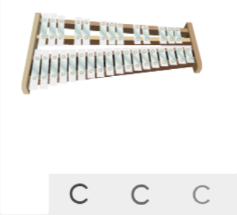
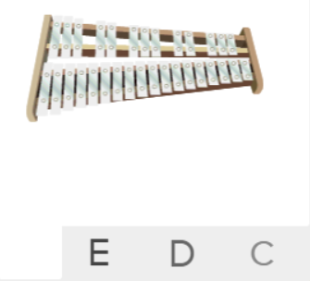
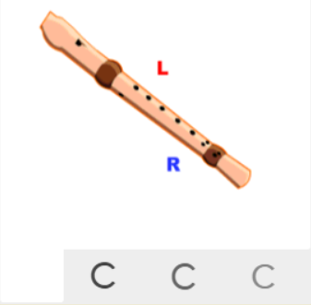
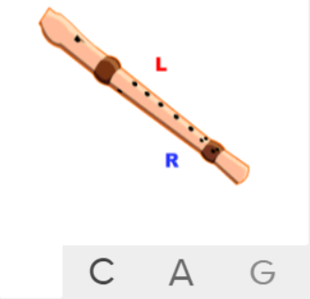
Shirley Heath Blackbird| Year 4 | Term: Summer 1
About This Unit
Themes: The Beatles, equality and civil rights.
Facts/info: The Beatles helped to reshape Western Pop music in the 1960s and are one of the most successful bands ever. The Beatles had four members: John Lennon, Paul McCartney, George Harrison and Ringo Starr. In the 1950s and 1960s, slavery had been abolished in America, but racism was still rife and life wasn't equal for African Americans. The civil rights movement – led by Martin Luther King Jr. – challenged this. There was a huge struggle for equality. Lots of dreadful things were going on and people were dying. After reading about this, Paul wrote the song Blackbird about a black woman, in support of the Black Power Movement.
Listen to 5 other songs by The Beatles ‘Yellow Submarine’ ‘Hey Jude’ ‘Can’t Buy Me Love’ ‘Yesterday’ ‘Let It Be’
Musical Activities (Using glocks / recorders)
Vocabulary
1. | ACOUSTIC GUITAR | The acoustic guitar is similar to the classical guitar, but generally has steel strings and a thinner neck.
2. | PERCUSSION | Musical instruments that generally. are used to establish rhythm.
3. | BIRDSONG | The sound of a bird or birds calling in a way which sounds musical.
4. | PENTATONIC SCALE | A musical scale having five notes.
5. | UNISON | Two or more voices or instruments playing the same note simultaneously.
6. | Pulse | The regular heartbeat of the music; it’s steady beat.
7. | Rhythm | Long and short sounds or patterns that happen over the pulse.
8. | Pitch | High and low sounds.
9. | Tempo | The speed of the music; fast or slow or in-between.
10. | Dynamics | How loud or quiet the music is.
11. | TEXTURE | Layers of sound. Layers of sound working together to make music interesting to listen to.
12. | Structure | The arrangement of a song.
13. | Compose | Writing your own music.
14. | Improvise | Playing notes that are not written for you.
15. | HOOK | A catchy combination of melody, lyrics and rhythm that stays in the listener's head
16. | RIFF | An ostinato; a repeated chord progression, pattern, or melody, often played by rhythmic instruments.
17. | MELODY | The tune.
18. | SOLO | A piece or a section of a piece that is played or sung by a single performer.
Listen and Appraise: Blackbird (Pop)
Themes: Equality, civil rights.
Instruments/voices you can hear: Solo male vocals in the verses, another male vocal in the choruses, acoustic guitar, percussion, birdsong.
Do the words of the song tell a story? Does the music create a story in your imagination? What story?

