Slide 1

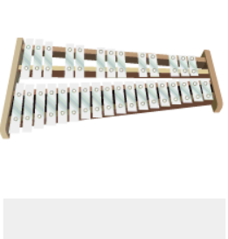
Shirley Heath Reflect, Rewind & Replay| Year 4 | Term: Summer 2
Listen and Appraise:
Listen to ‘Einstein on the Beach’ by Philip Glass and ‘Let It Be’ by The Beatles.
Structure: Instruments played.
Musical Activities
Play instrumental parts with the song by ear and /or from notation using the easy or medium part. Which part did you play?
Compose a simple melody using simple rhythms choosing from the notes C, D + E or C, D, E, G + A (the pentatonic scale).
Pentatonic scale
C D E
C D E G A
Perform and Share
The performance will include one of the following: Improvisations; instrumental performances; or Compositions.
Vocabulary and notation.

