Slide 1
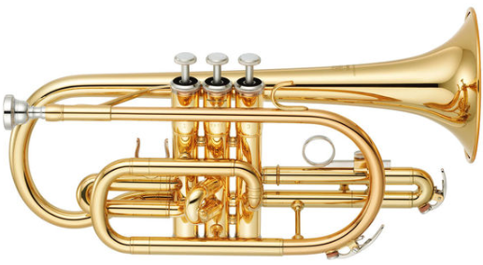
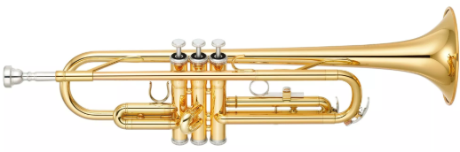
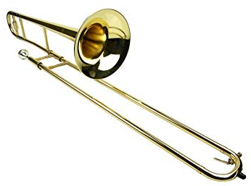
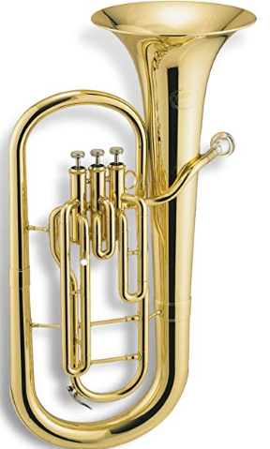
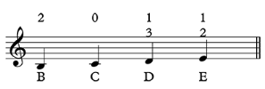
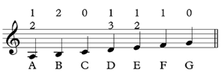
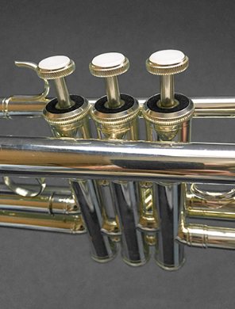


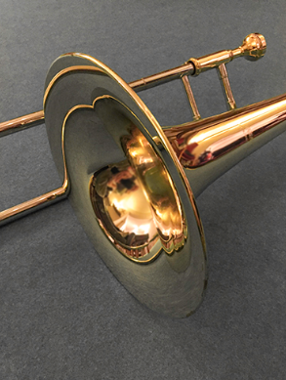
Shirley Heath
WCET Brass| Year 4 | Term: Termly per class (Autumn, Spring or Summer)
Brass Instruments
Cornet | Trumpet
Trombone | Baritone
Valved Instruments (Cornet, Trumpet and Baritone)
The first notes that you will learn and their valve positions are: Then:
Vocabulary
1. | CORNET | An “upper” brass instrument that looks like a smaller, wider trumpet.
2. | TRUMPET | A brass instrument consisting of a conical or cylindrical metal tube, a cup shaped mouthpiece and a flared bell.
3. | TROMBONE | A “lower” brass instrument consisting of a long cylindrical metal tube with two turns and having a moveable slide.
4. | BARITONE | A larger, valved “lower” brass instrument shaped like a trumpet but played upright.
5. | DYNAMICS | How loud or quiet.
6. | PITCH | How high or low the notes played are.
7. | TEMPO | The speed.
8. | PULSE | The “heat beat” of a piece (this should be steady and regular).
9. | RHYTHM | A strong, regular repeated pattern of movement or sound.
10. | DURATION | An amount of time or how long or short a note, phrase, section, or composition lasts.
Non-valved Instruments (Trombone)
Some slide positions and notes that you will learn are:

