Slide 1
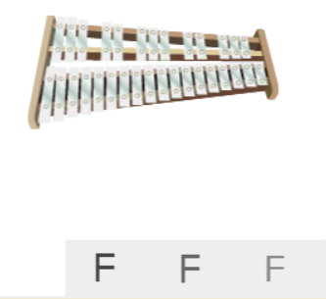
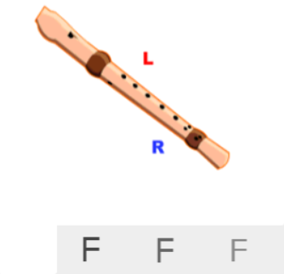
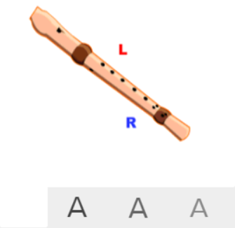
Shirley Heath Dancing In The Street| Year 5 | Term: Summer 1
About This Unit
Theme: Motown.
Facts/info: Dancing In The Street was written by Marvin Gaye, William "Mickey" Stevenson and Ivy Jo Hunter. It first became popular in 1964 with Martha And The Vandellas. The track was recorded on the Motown record label and became one of its signature songs.
Listen to 5 other Motown songs: ‘I can’t Help Myself (Sugar Pie Honey Bunch’ by The Four Tops ‘I Heard it Through the Grapevine’ by Marvin Gaye ‘Ain’t No Mountain High Enough’ sung by Marvin Gaye and Tammi Terrell ‘You Are the Sunshine of My Life’ by Stevie Wonder ‘The Tracks of My Tears’ sung by Smokie Robinson
Vocabulary
1. | SOUL | Music that originated in black American gospel singing, is closely related to rhythm and blues, and is characterized by intensity of feeling and earthiness.
2. | GROOVE | The rhythmic part of the music that makes you want to move and dance.
3. | RIFF | An ostinato; a repeated chord progression, pattern, or melody, often played by rhythmic instruments.
4. | BASS LINE | The lowest line of a piece of music. It is usually played on a bass instrument, like the double bass or bass guitar.
5. | BACKBEAT | A steady pronounced rhythm stressing the second and fourth beats of a four-beat measure.
6. | BRASS SECTION | This includes the trumpet, tuba, trombone, French horn, bugle, and cornet, just to name a few.
7. | HARMONY | When people play or sing more than one tone at the same time.
8. | HOOK | A catchy combination of melody, lyrics and rhythm that stays in the listener's head
9. | MELODY | The tune.
10. | Compose | Writing your own music.
11. | Improvise | Playing notes that are not written for you.
12. | COVER | A new performance or recording by a musician other than the original performer or composer of the song.
13. | Pulse | The regular heartbeat of the music; it’s steady beat.
14. | Rhythm | Long and short sounds or patterns that happen over the pulse.
15. | Pitch | High and low sounds.
16. | Tempo | The speed of the music; fast or slow or in-between.
17. | Dynamics | How loud or quiet the music is.
18. | TIMBRE | A musical dimension that describes the quality and character of the sound of the instruments used.
19. | TEXTURE | Layers of sound working together to make music interesting to listen to.
20. | Structure | The arrangement of a song.
Listen and Appraise: Dancing In The Street (Motown)
Structure: Intro, verse 1, chorus, bridge, verse 2, chorus, bridge, verse 3.
Instruments/voices you can hear: Female voice and female backing vocals, keyboard, drums, bass guitar (rhythm section), brass section (trumpet, trombone and sax).
Can you find the pulse as you are listening? Is the tempo fast, slow or in-between? Dynamics? Texture?
Musical Activities (Using glocks / recorders)
Easy part
Medium part

