Slide 1
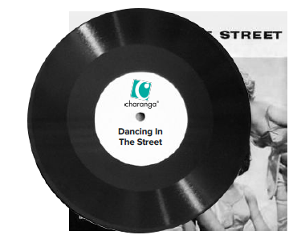
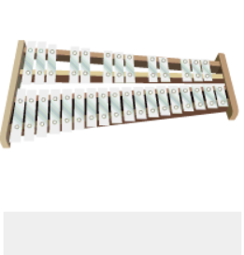
Shirley Heath Reflect, Rewind & Replay| Year 5 | Term: Summer 2
Listen and Appraise:
Listen to 5 other pop ballads.
Structure: Instruments played.
Musical Activities
Play instrumental parts with the song by ear and /or from notation using the easy or medium part. Which part did you play?
Compose a simple melody using simple rhythms choosing from the notes G A B C D
G A B C D
Perform and Share
The performance will include one of the following: Improvisations; instrumental performances; or compositions.
Vocabulary and notation?

