Slide 1
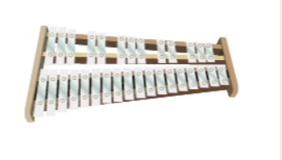
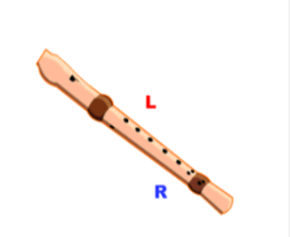
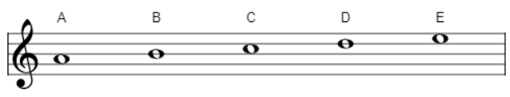
Shirley Heath Music and Me| Year 6 | Term: Summer 1
About This Unit
Theme: Music and Me: Identity
Facts/info: Anna Meredith - Something Helpful. Anna is a British composer and performer of Electronic and Acoustic music. Shiva Feshareki - O and V-A-C Moscow. Shiva is a turntablist who works with orchestras, she DJ’s and composes. She is British of Iranian descent. Eska Mtungwazi - Heroes & Villains and Shades Of Blue. Eska is a London-born UK singer-songwriter and multi-instrumentalist. Afrodeutsche - And! and The Middle Middle. Afrodeutsche is a British-born Ghanaian/Russian/German composer, producer and DJ based in Manchester. Listen to and find out about 6 other artists from the Inspirational Women’s Timeline.
Musical Activities (Using glocks / recorders)
Vocabulary
1. | RACISM | The opinion or belief that a particular race of people is better than another race or races.
2. | RAP | A vocal technique in which the performer speaks rhythmically against a steady beat.
3. | LYRICS | The words of a song.
4. | TURNTABLIST | The art of changing sounds to create music using phonograph turntables and a DJ mixer.
5. | DJING | A person who conducts a program of recorded music on radio, on television, or at discotheques or other dance halls.
6. | PRODUCER | A record producer or music producer oversees and manages the sound recording and production of a band or performer's music.
7. | ELECTRONIC MUSIC | music which is made with electronic equipment such as synthesizers or computers.
8. | ACOUSTIC MUSIC | Unamplified music that produces sound only by vibrating air and acoustic means, instead of through electronic or virtual instruments.
Listen and Appraise: Music from four different inspirational female artists
What could you hear? Did you recognise any instrumental sounds or voices?
Did you like the music? Why? Or why not?
Did anything stand out to you about any of the pieces you listened to?

