Slide 1
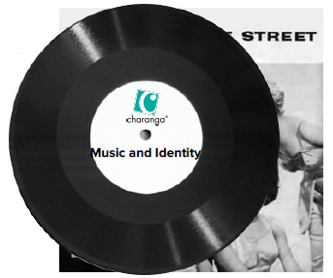
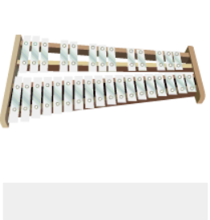
Shirley Heath Music and Identity (Reflect, Rewind and Replay)| Year 6 | Term: Summer 2
Listen and Appraise:
Listen to music from 6 different genres of music throughout history.
Structure: Instruments played.
Musical Activities
Play instrumental parts with the song by ear and /or from notation using the easy or medium part. Which part did you play?
Compose a simple melody using simple rhythms choosing from the notes C D E F G
C D E F G
Perform and Share
The performance will include one of the following: Improvisations; instrumental performances; or compositions.
Vocabulary and notation?

