Slide 1

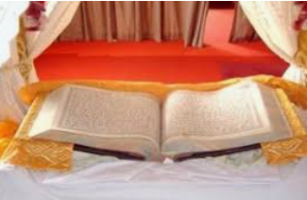
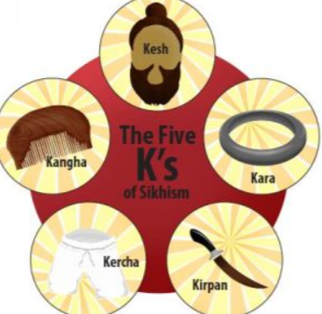
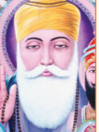
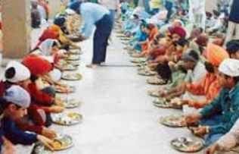
Shirley Heath (Sikhi) | Year3|Summer 1 Do Sikhs think it is important to share?
Gurdwara Sikh place of worship
Vocabulary
Share | To let someone else have or use something that belongs to you.
Community | A group of people living in the same place and having the same things in common.
Guru | Teacher: used in Sikhism to refer to the ten human Gurus.
Gurdwara | Sikh place of worship: It means the doorway to the guru
Guru Granth Sahib | Sikh Holy book. It is seen as a living teacher and treated with great respect
Vaisakhi festival | A major Sikh festival celebrating the formation of the Khalsa and new year.
Khalsa
Karah Parshad | A dish offered to visitors at the Gurdwara. It is a pudding made from flour, sugar and butter.
Sewa | Selfless service to others.
Knowledge
Sharing is a key part of Sikh beliefs and practice Guru Nanak taught people to believe in one God and to treat all people equally He believed everyone should work hard, be honest and share what they have with others The 3 Golden Rules of Sikhi: Naam Japo (repeating God’s name) Kirat Karni (being honest) Vand Ke Chakna (Sharing with others)
Guru Granth Sahib - Sikh Holy book
The Langar
A free meal given to all who
come to the Gurdwara. It is
Vegetarian so everyone can
have it.
The 5 K’s. The symbols of Sikhism worn by Sikhs:
Kesh Kangha
Kara Kercha
kirpan
Guru Nanak is first living Guru and the
founder of Sikhi.

