Slide 1
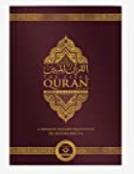
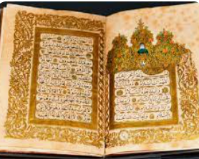
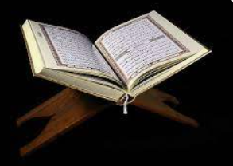
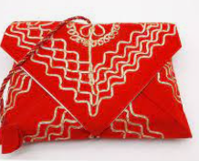
Islam | Year 4|Summer 1 How does the Qur’an influence Muslims today?
Knowledge The Qur’an
The Qur’an is the Islamic holy book. It is written in Arabic. Muslim always wash their hands before touching the Qur’an. When used, it is on a stand. When not used it is wrapped in a clean cloth. When not being read it is always the highest book in the room. The Qur’an is the word of Allah. It should be treated with respect a The instructions inside should be followed. The Qur’an teaches Muslims how to lead good lives and how to follow God.
Vocabulary
Muslim | Muslims are people who follow the religion Islam.
Arabic | Is the language the Qur’an is written in. It is written from right to left.
duty | Something that one is expected or required to do.
respect | Looking up to someone or showing you admire them.
Allah | Is the Arabic word for God.
Influence | To affect or change someone or something in an important way.
Values | The things that you believe are important in the way that you work and live.
The Qur’an is
the Islamic
holy book
.
It is written in Arabic
When it is in use
it is placed on
a special stand.
When it is not in use
it is wrapped in a cloth
as a sign of respect.

