Slide 1
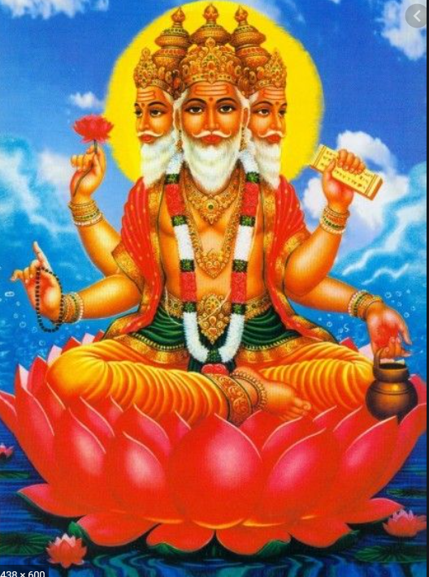
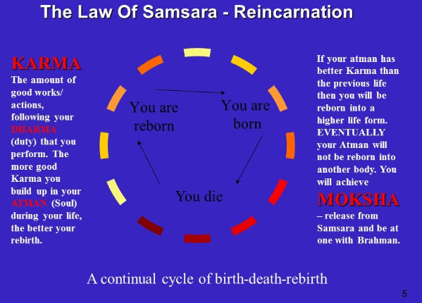
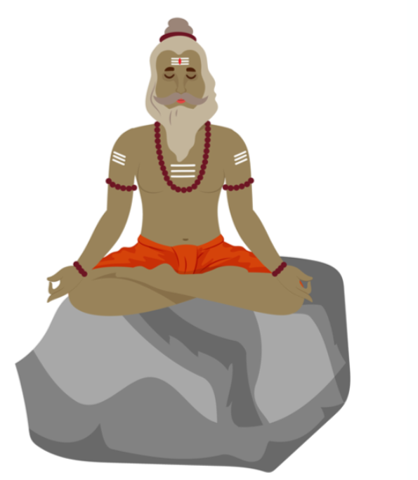
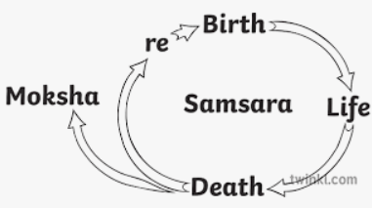
Sanatana Dharma - Do beliefs in karma, Samsara and Moksha help Sanatani’s lead good lives? ) | Year 5 Summer 1
We are learning about the cycle of life, death and rebirth and understanding why it’s important to do good deeds
Knowledge
In a life time, Sanatanis believe that people build up positive and negative karma, based on their actions in that lifetime. This karma affects their future lives. People must take responsibility for their actions in this lifetime and the next. Sanatanis aim to live each life in a better way than the life before. They believe that the soul is eternal and lives through many lifetimes, in one body after another. The soul can be born in a human form, or that of a plant or animal. Everything Sanatanis do will have a consequence either in this life or the next. This belief makes Sanatanis help others around them be the best they can be – to help them gain the best situation next time.
Vocabulary
Consequence | These are what happens immediately after a behaviour. Some consequences are positive and some are negative.
Dharma | Duty – this is a central part of a Sanatani’s daily life.
Karma/Action | Actions and the consequences of our actions in this life and the next
Samsara /reincarnation | Sanatanis believe in reincarnation, the cycle of rebirth - a belief that the soul lives many lifetimes, in one body after another.
Moksha /freedom | The final release from the cycle of rebirth – to join with Brahman.
Brahman | Brahman is the concept of God in Sanatana Dharma. Sanatanis believe that Brahman is everywhere
Sadhu (male) Sadhvi (female) | A person who has turned away from ordinary life to live a more spiritual path.
Soul | The spiritual part of a human being or animal.
Eternal | Lasting or existing forever.
Brahman Universal God
Sadhu/Sadhvi

