Slide 1
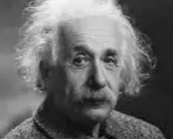
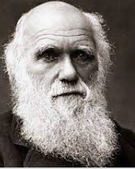


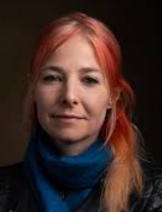
How do inspirational people impact on how Humanists live today? | Year 6 Summer 1
He was born in Germany in 1879. He studied Maths and Physics at college. He created the theory of relativity which changed the way that the world thought about time and space. He was awarded the Noble Prize for Physics in 1921.
Knowledge
Humanists believe: There is no evidence of a god – science gives many answers to things that were previously linked to gods. We have one life – we need to make the best of it. It is our responsibility to treat humans and other living things ethically, fairly and positively We need to take personal responsibility for our actions. We have the potential to achieve great things which will benefit humanity and future generations Humanists value freedom, empathy, reason and human rights Humanists respect people’s right to hold their own beliefs; however they are opposed to human rights being violated which can happen in some societies, some of which may be governed by religious law
Vocabulary
Actions | What is done.
Impact | The effect or influence someone has on others.
Role model | A person who others look to as a good example
Humanism Humanist | Is a non-religious worldview. Is a person that follows Humanism
Atheist | A person that doesn’t believe in a god or deity or that there is life after death
Inspiration | Someone or something that inspires you and makes you want to do something.
Worldview | This is a view of the world. Some are religious views. Some are non-religious views.
Golden rule | To treat others as you would like them to treat you.
Albert Einstein
(Scientist)
Humanists believe that science can
bring the solutions or answers to many problems so as Scientists, they may find them inspiring.
As a boy, he collected
insects and did experiments.
He travelled on the HMS Beagle to record animals he’d seen. He went to the Galapagos islands. He invented the theory of evolution by natural selection. He found out that plants and animals change depending on their
Environment.
Charles Darwin
(Naturalist)
Alice Roberts (Professor and president
and vice president of Humanists UK.
The ‘Happy Human’ is a symbol
associated with Humanism – it is
designed to highlight the potential
of humans and the ability to
Celebrate life and achievements
which benefit humankind and
other living things.
Alice studied medicine at Cardiff
University. She studied diseases in
ancient human remains. She is a
human bone specialist.
Humanists believe in the Big
Bang theory.
The ideas of the people in the photos may match those of a Humanist and they may therefore be a role model or inspiration to them.

