Slide 1
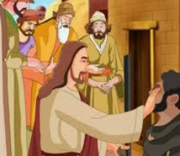
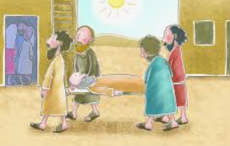
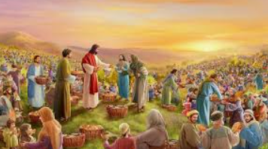
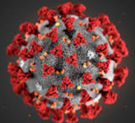


Shirley Heath Jesus’ Miracles (Christianity) | Year3|Summer 2
We are learning to understand whether Jesus could heal people or was there some other explanation?
Knowledge
What do Christians believe? | Christians believe that Jesus is God in human form so he has the power of God and he is able to perform miracles.
How do you get better when you are poorly? | Is it a miracle or do you do something else to make you better? Take medicine Rest/relax Drink water Sleep
Did Jesus perform miracles? | Stories do not have to be true to be meaningful. Christians believe that Jesus could make people better even though he wasn’t a doctor. People that have this ability today are: doctors, nurses, surgeons, physio therapists.
Vocabulary
Miracle | An extraordinary, outstanding or unusual event taken as a sign of the power of God.
Heal | To make or become well again.
Incarnation | The belief that Jesus is God in Human form. Christians believe this is why he was able to perform miracles.
Paralysed | To cause or be unable to move some part of the body.
Blind | Unable to see. Loss of sight.
Jesus | The central figure of Christianity. Christians believe he is the son of God.
preach | A person who gives talks on religion.
sin | A sin is when someone disobeys God’s rules.
Loaves | The plural of a loaf of bread.
Jesus healed a blind man
Jesus healed a paralysed man
If you could perform one miracle for the world, what would it be?
He fed 5,000 people with
5 loaves and 2 fishes
For everyone to be happy
No disease

