Slide 1
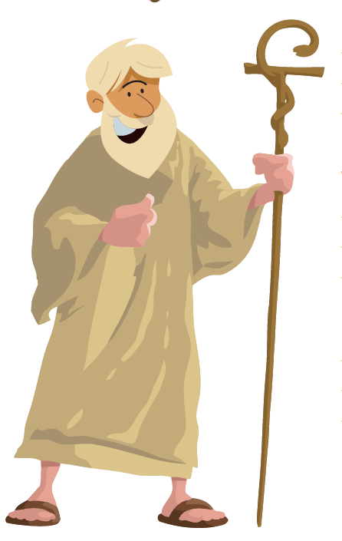
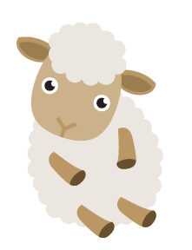
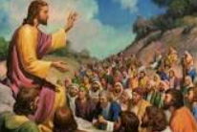
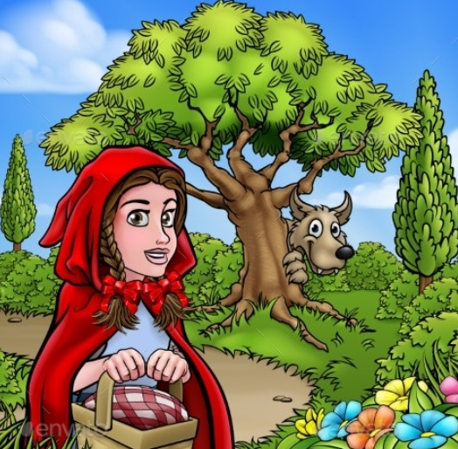
Shirley Heath The Lost Sheep (Christianity) | Year 4|Summer 2
We are learning to understand what the story of the lost sheep means?
Knowledge
Parables Jesus told many parables. It was always about situations that people could understand. There would have been lots of sheep on hillsides during this time and sheep usually stay together in their flock. A sheep strays from the flock. The shepherd realises one sheep is missing and puts himself in danger to find one sheep when he has 99 that are safe. Modern Day story - Little red riding Hood. Little red Riding Hood plans to visit her poorly Grandmother who lives the other side of the wood. On the way she meets a wolf who tricks her. She ‘goes off the path’ and doesn’t do what she is supposed to do. The lost sheep The shepherd searched for his sheep even though that might have been dangerous. He was willing to make that sacrifice to find the sheep that had not stayed where it should have. When he brought it back everyone was happy. God/Jesus are the shepherds. Jesus is the ‘good shepherd’ Jesus is the shepherd who is willing to come and find somebody who might not be easy to like because they do the wrong thing. Reflection Can you think of a time when you have chosen to break a rule or make a wrong decision? Can you think of a situation where someone has helped you return to the right way of behaving or acting?
Vocabulary
Christian Love | Love at a higher, deeper and selfless level. It is an unselfish love where people have a concern for the welfare of others.
Parable | A story with a meaning or moral. These stories always had a message where the character or item represented other things.
Stray | Move away from a group or from the right path
Rule | Guide lines for how people should behave
Sacrifice | Give up something for the sake of something else.
Moral | A lesson that can be learned from a story.
Shepherd | A shepherd is a person who looks after sheep.
Jesus | The central figure of Christianity. He will help people who stray to find the ‘right path’ again.
Willing | Ready, eager and prepared to do something.
sheep
shepherd
Jesus telling a parable
Link to a Modern day story

