Slide 1
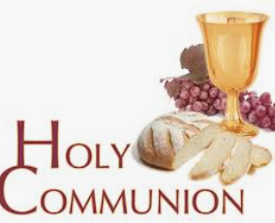

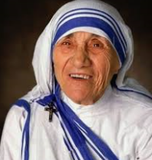
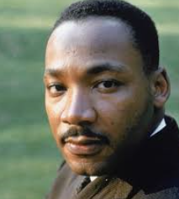
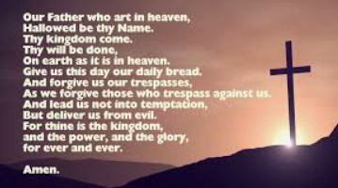
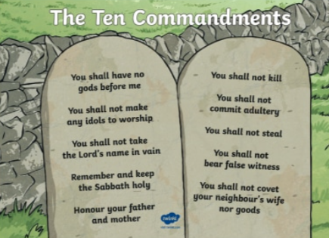
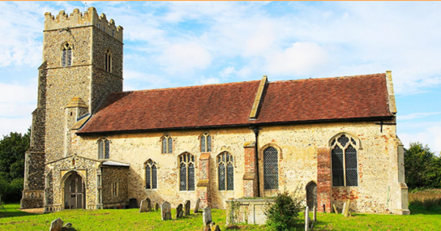
Shirley Heath Commitment to God (Christianity) | Year 5|Summer 2
We are learning to understand how Christians show their commitment to God and to evaluate if there is a best way.
Knowledge
How Christians show commitment to God follow the ten commandments. say the Lord’s Prayer. attend church every week take holy communion. The bible states ‘Love your neighbour as yourself’. If a Christian is committed to God they will show love, joy, peace, patience, kindness, gentleness, faithfulness and self control. Not jealousy or conceitedness Important Christian people Famous Christians such as Martin Luther King and Mother Teresa dedicated their lives to helping others to show their commitment to God. Christian Aid week Christian Aid is a Christian charity. During Christian Aid week each May, money is raised around the world to help families to overcome poverty. Difficult choices Sometimes we have situations where we have to make a choice between 2 or more options. Is it okay to tell lies if we are protecting someone/something?
Vocabulary
Ten commandments | A list of religious rules that Christians have to follow. They were written on pillars of stone and brought down from Mount Sinai by Moses.
Lies | Not telling the truth on purpose. Not being honest.
Neighbour | Your neighbour means important people in your life – Immediate family, extended family, friends, community.
Commitment | Is dedicating yourself to something.
Dedicate | Give time or effort to a particular task or purpose.
Dilemma | A situation in which a difficult choice has to be made between 2 or more options.
Holy Communion | A Christian activity where bread and wine are consumed to remember Jesus’ death on the cross. The wine represents his blood. The bread represents his body.
The Lord’s prayer | This is a Christian prayer that Jesus taught his disciples as a way of praying.
Community | A group of people living in the same place and having
Mother Teresa
Martin
Luther King
Church

