Slide 1
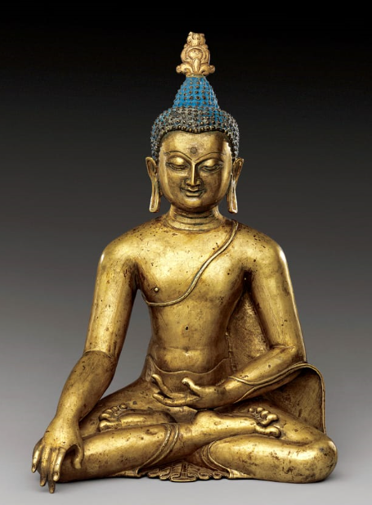
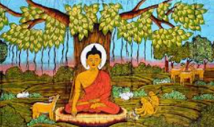
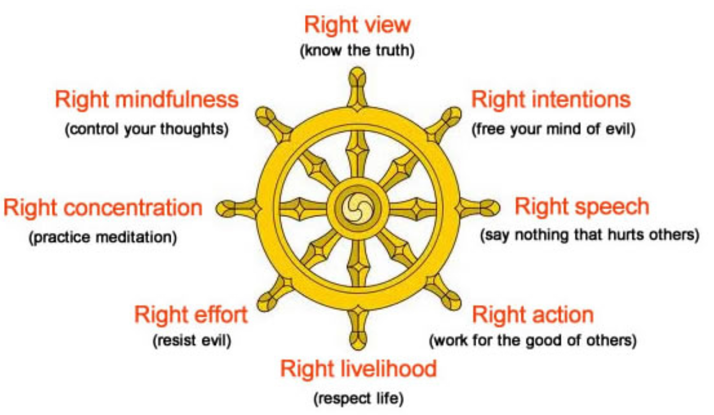
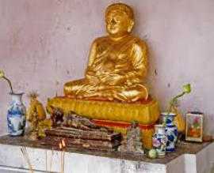
Shirley Heath What is the best way for a Buddhist to lead a good life? | Year 6 Summer 2
We are learning how Buddha’s teachings make a difference to how Buddhists choose to live.
Knowledge
Siddharta Gautama was the son of a king and queen who became the founder of Buddhism. His father insisted that he should never see suffering so he had to stay in the grounds of his palace. He was never exposed to the outside world so he never saw suffering and hardship. He grew frustrated and sneaked out of the palace. He then saw: a dead man, an old man and a poor man. He became affected by what he saw. He ran away and decided to become a holy man to find out more. He meditated under a Bhodi tree where he became enlightened. The Buddha taught that to live a good life without being selfish or greedy would make the world a better place. To help people to know what to do and what not to do he gave them the noble 8- fold path.
Vocabulary
Siddharta Gautama | This Buddha was a philosopher, mediator, spiritual teacher and religious leader.
Noble Eightfold Path | The Noble Eightfold Path is 8 things people can choose to do to help them lead good lives which would make the world better for everyone and everything.
Consequence | The effect, result or outcome of something that happened earlier.
Meditation | An activity where a person uses mindfulness to achieve a mentally clear and emotionally stable state of mind
Enlightenment | Understanding of how to be happy and free from suffering.
Influence | A thing or a person that has the power to affect another.
Decision | To make up your mind about something.
Self discovery | Discovering your own character and individuality.
The Noble Eightfold Path
Wheel of life (symbol of Buddhism)
shrine
This is a place in the home where Buddhists pray. It usually has a statue of a Buddha, candles, incense, food, flowers and purified water.

