Slide 1
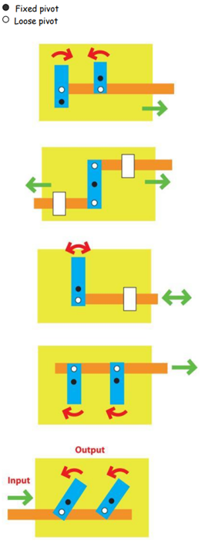

Shirley Heath Moving Pictures| Year 3 | Summer Term
DESIGN BRIEF
The Year Three children have read and investigated lots of wonderful books this year. Therefore, the children have been challenged to create a moving picture for the Year 2 children moving up to Shirley Heath, showcasing all of the wonderful units we study. You will need to think about what your picture will look like as well as how it will move to highlight the most important (or your favourite!) parts of the story.
KEY VOCABULARY
Mechanism | a device used to create movement in a product
Lever | a rigid bar which moves around a pivot
Pivot | loose pivot: a paper fastener (eg. split pin) that joins card strips together fixed pivot: a paper fastener that joins card strips to the backing card
Linkage | a collection of parts joined together to change or help movement
Bridge | a short card strip used to keep lever and linkage mechanisms in place and control movement
Input/output | when you push the card strip (input movement), the lever moves (output movement)
TYPES OF MOVEMENT
Reciprocating | Forwards and backwards movement along a straight line
Rotary | Movement that goes around in a circle
Oscillating | Side to side movement in an arc

