Slide 1
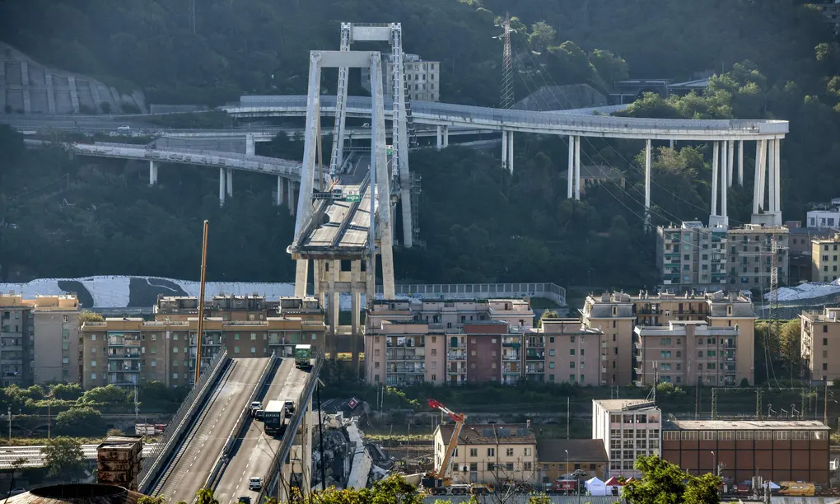
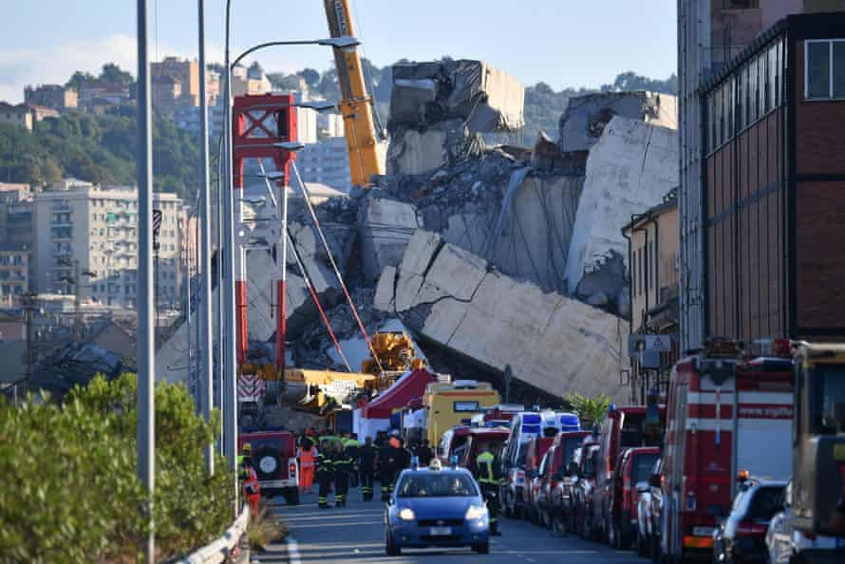
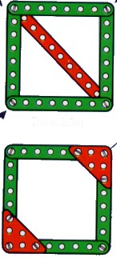
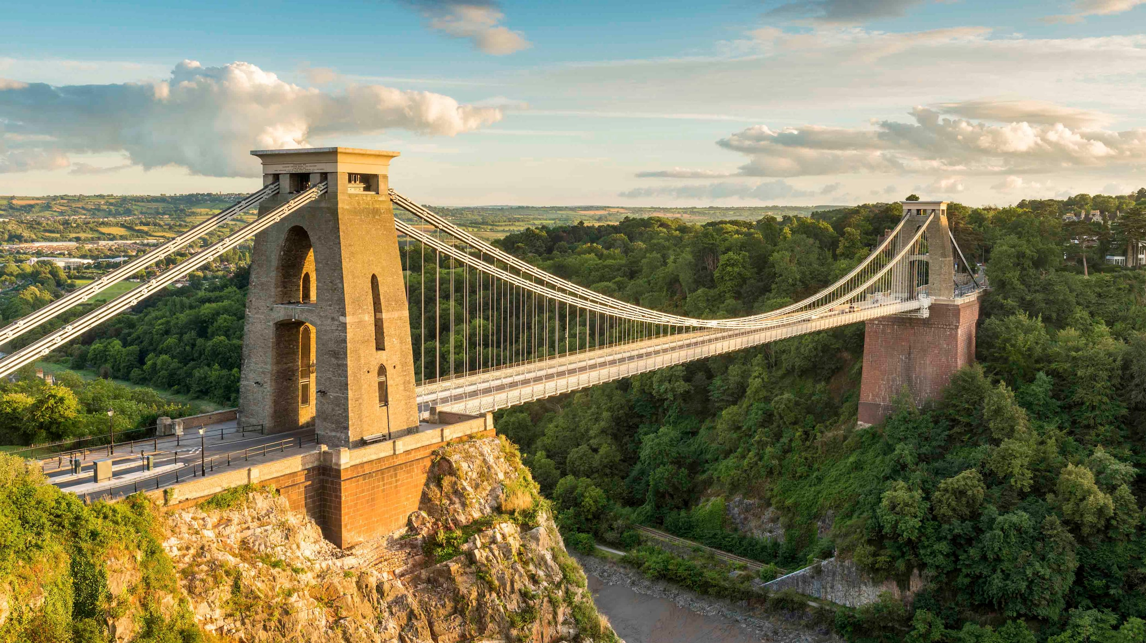
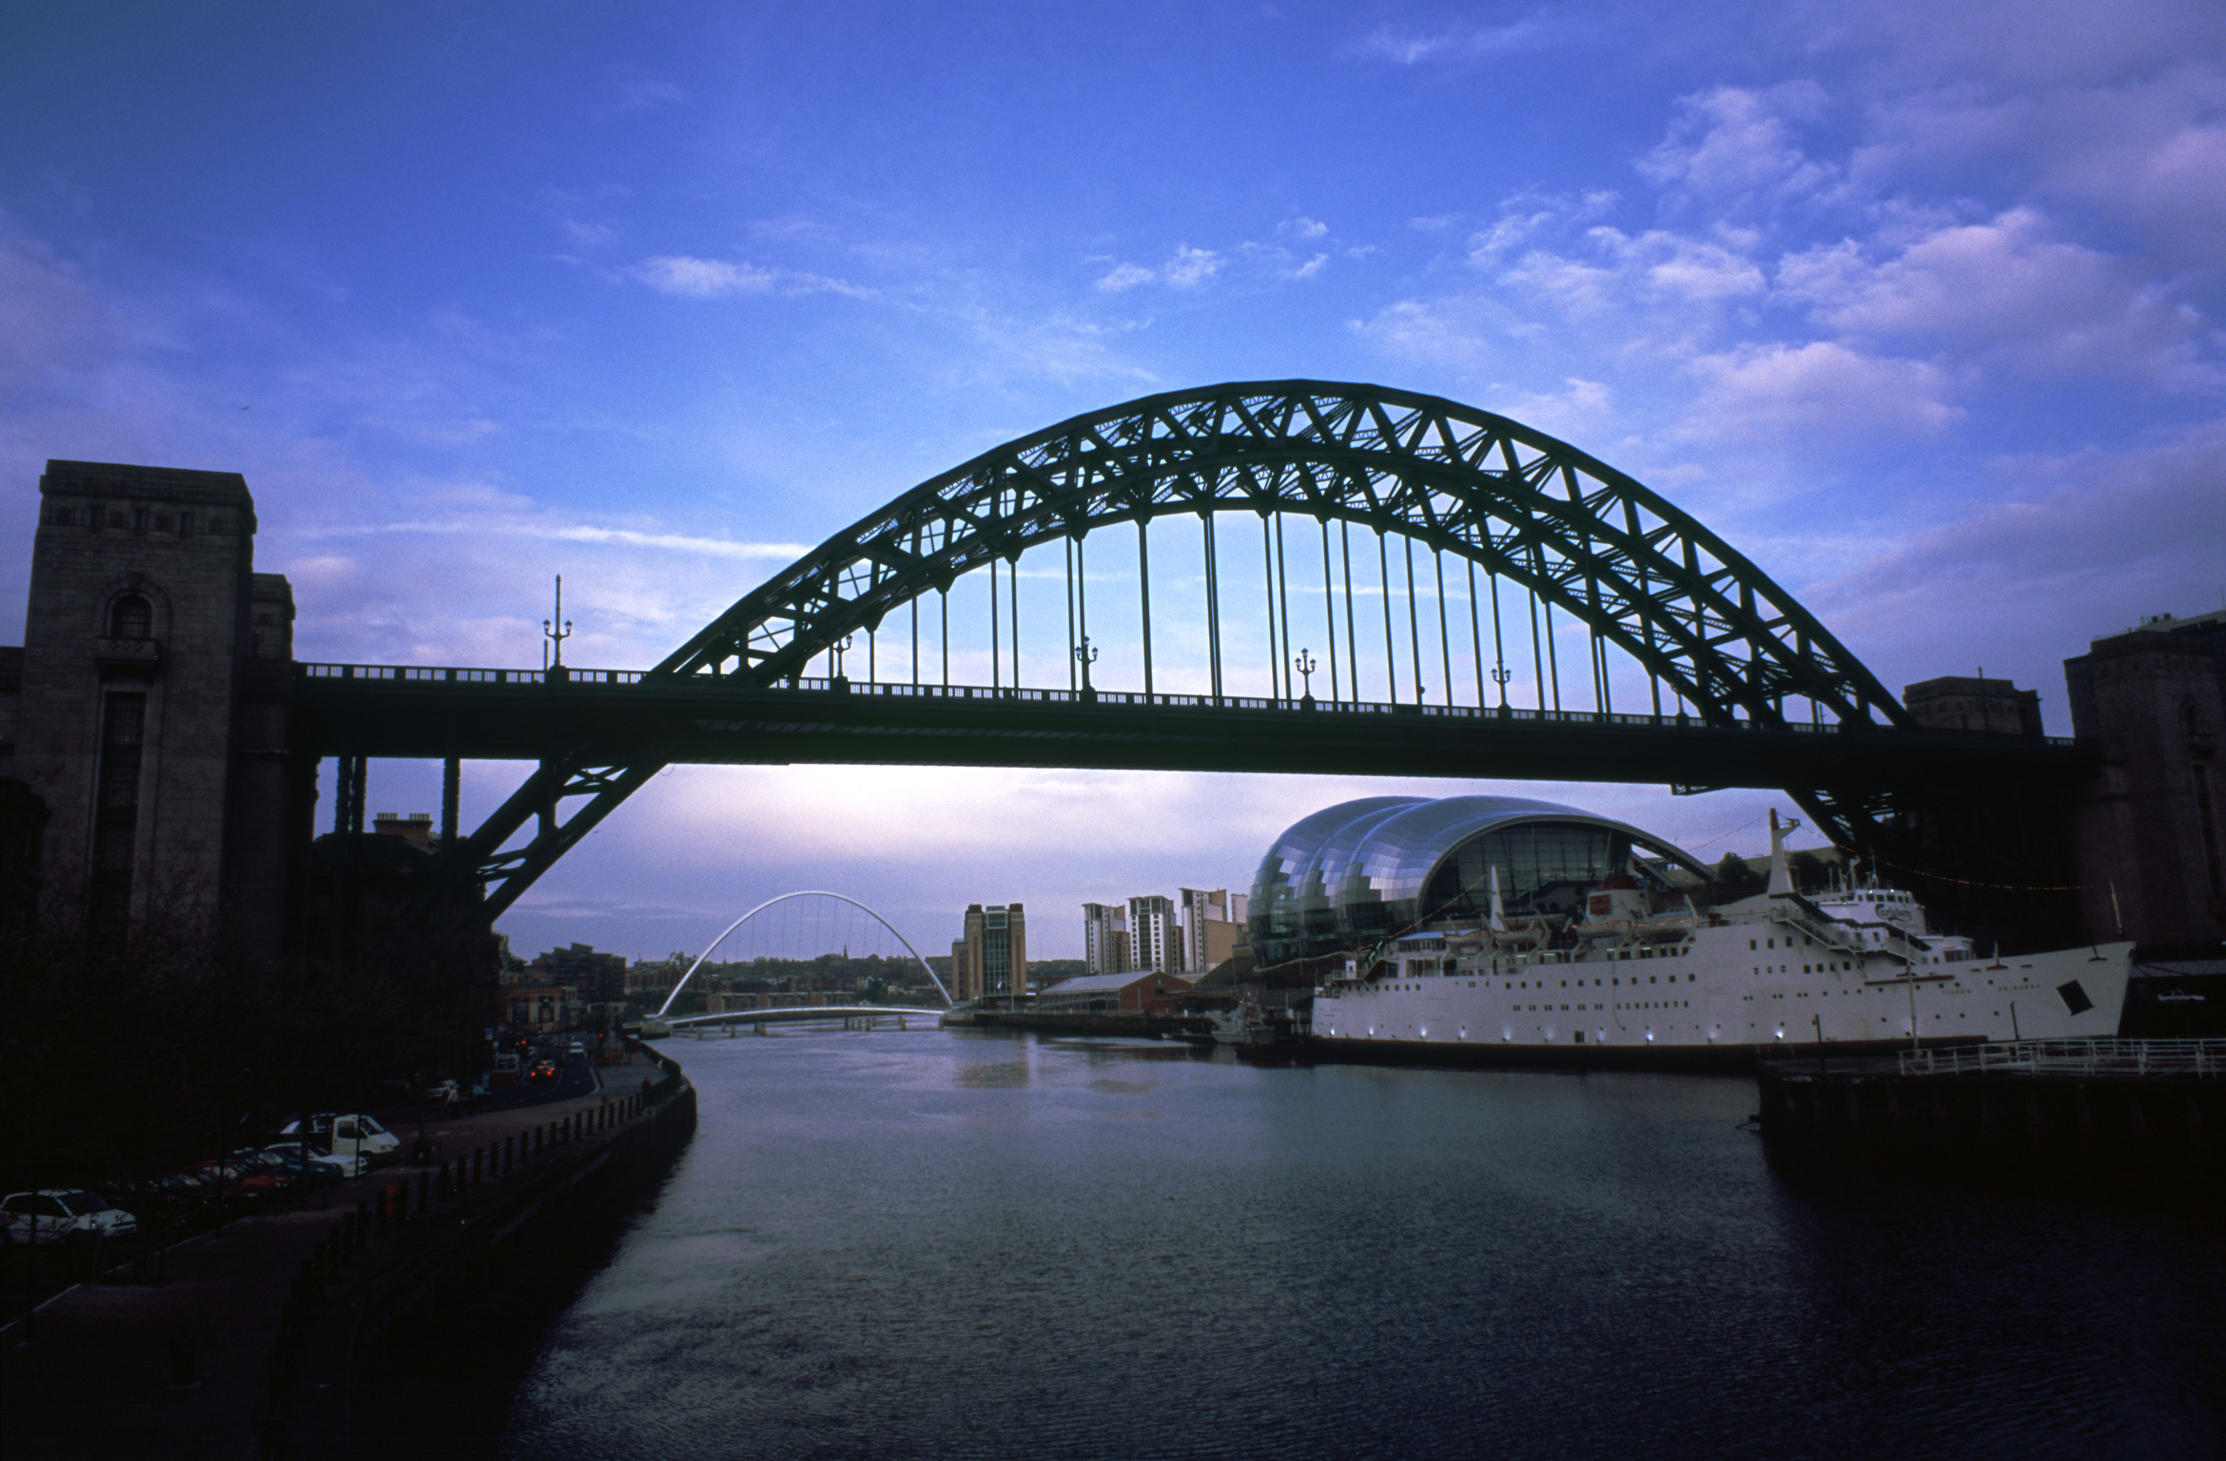
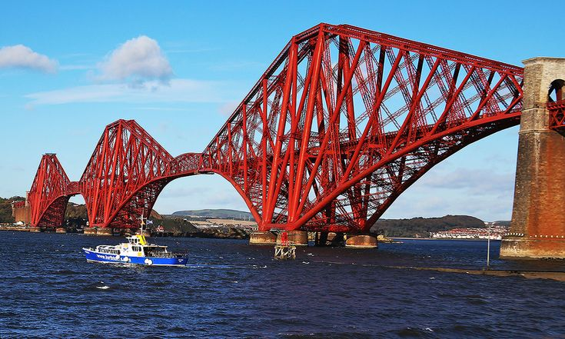
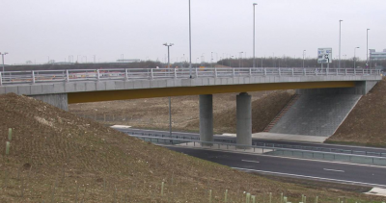
Shirley Heath Bridges| Year 4 | Spring Term
KEY EVENT MORANDI BRIDGE
 | Morandi was one of the longest concrete bridges in the world when it opened in September 1967. However, in August 2018, a 200-metre section of the bridge collapsed, including one of its three supporting towers. As well as being a tragedy for residents of Genoa, the collapse was a huge blow to Italy’s once-proud engineering history.
VOCABULARY
structure | buildings or other objects constructed from several parts
abutments | retaining walls supporting the ends of a bridge.
beams | long, sturdy pieces of squared material used to support a structure
trusses | structures of members (beams) which are connected at their ends (joins).
suspend | something which hangs, unsupported from below
KEY SKILLS
Joining Using the most appropriate material to secure two or more pieces of a structure.
Strengthen, stiffen and reinforce Using additional materials or techniques to improve the strength of the structure.
Triangulation A technique used to reinforce structures which have edges meeting at angles (usually 90°).
DESIGN BRIEF
The Morandi Bridge disaster brought devastation to Genoa: it is essential that it doesn’t happen again! Your task is to design a bridge that can hold as much weight as possible at its centre. Your bridge will need to stretch across an opening of at least 30cm and stand 30cm above ground.
TYPES OF BRIDGES
# Suspension Bridges Such as: Clifton Suspension Bridge (UK), Golden Gate Bridge (San Francisco). | # Arch Bridges Such as: Tyne Bridge (Newcastle), Sydney Harbour Bridge (Australia). | # Cantilever Bridges Such as: Forth Bridge (Scotland), Quebec Bridge (Canada). | # Beam Bridges Such as: Moselle Viaduct (Germany), Lake Pontchartrian Causeway (USA).

