Slide 1
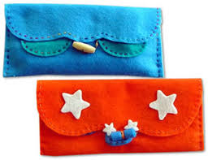
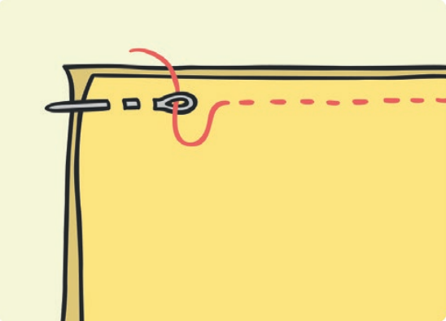
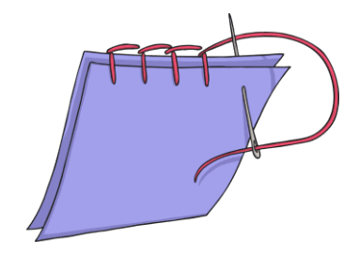
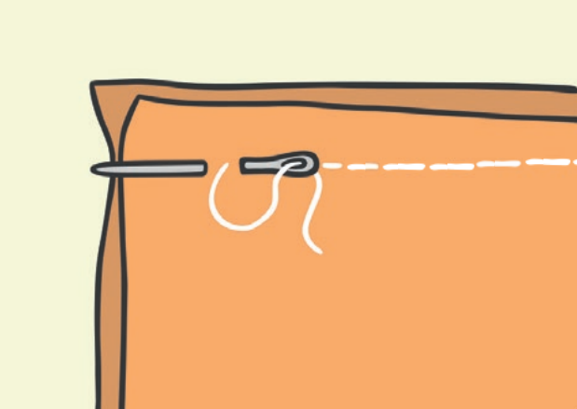
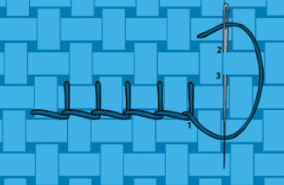
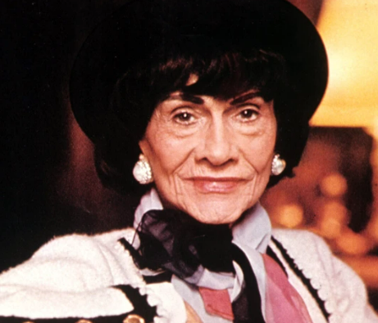
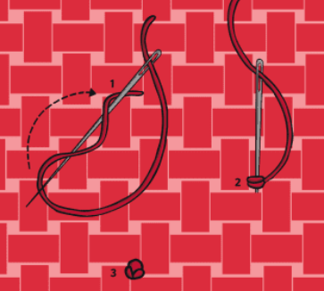
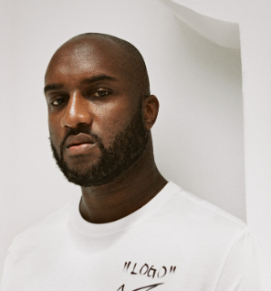
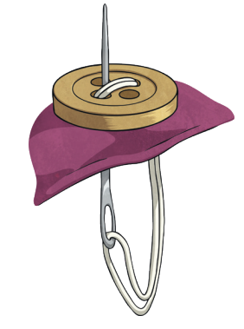
Shirley Heath Creating a Pencil Case | Year 5 | Summer Term
SKILLS I WILL LEARN
Sewing
Design a product to fit a design brief
Measure and cut fabric to size
Thread a needle using cotton
Stitch types: running, back, over, French knot
Join two pieces of fabric
Use a pencil to draw a pattern into foam
Press and roll pattern to form a print
Attach decoration and clasp using over stitch
Evaluate the function of my product
KEY KNOWLEDGE
PREVIOUS LEARNING | Running Stitch A very simple stitch used to join fabrics. It is made up of a straight line of stitches of equal length.
 | Over Stitch Used on the raw edge of the fabric, this stitch uses short stitches over the raw edge of the fabric to neaten edges and to prevent unraveling of threads.
NEW LEARNING | Back Stitch Similar to a running stitch. This time gaps are filled by taking the second stitch back over to meet the first.
 | Blanket Stitch This stitch carries over the edge of the fabric but joins the stitches along the fabric edge by looping the thread.
 | French Knot A decorative stitch, the thread is wrapped around the needle before bringing back through the fabric.
 | Securing a button The thread is passed through the holes within the button in order to secure it to the fabric.
Design Brief: Inspired by Chanel, Smiggle wants to create a new pencil case specifically designed for Year 6 children.
KEY VOCABULARY
Function | An activity that is natural to or the purpose of a person or thing.
Aesthetic | Concerned with beauty or the appreciation of beauty.
Join | Points where two pieces of fabric have been stitched together
Clasp | A device with interlocking parts used for fastening things together.
Fasten | Close or do up securely.
Purpose | The reason for which something is done or created or for which something exists.
Stitch | A loop of thread or yarn resulting from a single pass or movement of the needle in sewing, knitting, or crocheting.
Sew | Join, fasten, or repair (something) by making stitches with a needle and thread or a sewing machine.
FAMOUS DESIGNERS
 | Gabrielle Bonheur "Coco" Chanel was a French fashion designer and businesswoman. The founder and namesake of the Chanel brand, she was credited in the post–World War I era with popularizing a sporty, casual chic as the feminine standard of style.
 | Virgil Abloh was an American fashion designer and entrepreneur. One of the most influential and respected fashion designers of his generation. In 2013, Abloh founded Off-White. 2018, Abloh was named artistic director of Louis Vuitton's menswear he designer street wear for everyday people.

