Slide 1
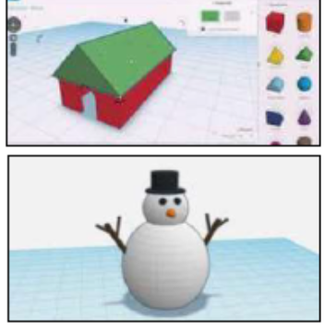
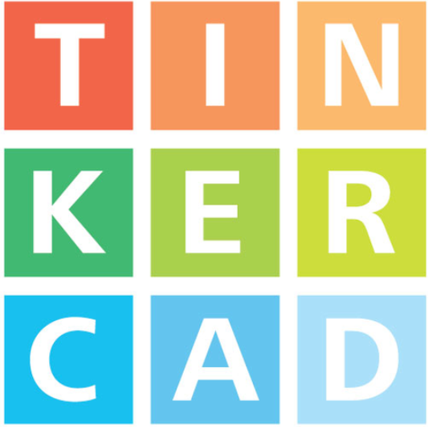
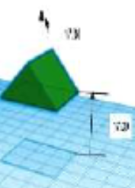
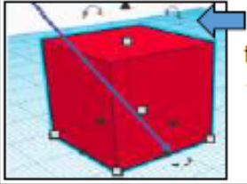
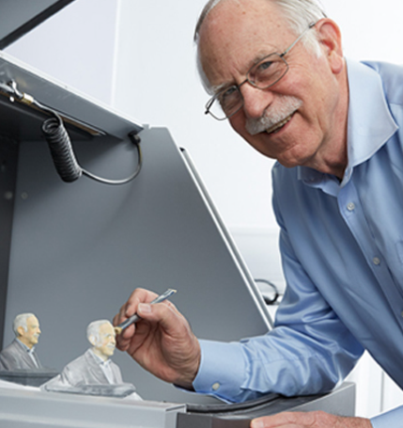
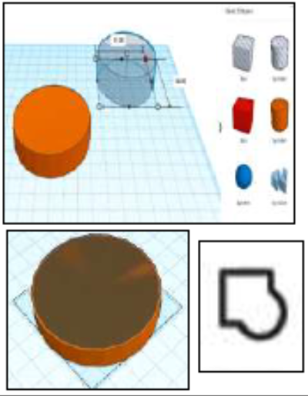
Shirley Heath 3D printing| Year 6 | Summer Term
OVERVIEW
 | 3D means three-dimensional, or having 3 dimensions. For example, a box is a 3D shape whereas a square is a 2D shape. 3D modelling involves using a computer software to create 3D shapes, in order to produce models of real-world objects. To be introduced to 2Design and Make and the skills of computer aided design (Tinkercad). To understand designing for a purpose. To understand printing and making.
KEY VOCABULARY
3D | Something that has three dimensions; height, width and depth.
CAD – Computer aided Design | A CAD computer program or app allows you to design a 3D object or environment in 2D and visualize it in 3D on the screen from many angles.
Modelling | The activity of making models
3D Printing | - The action or process of making a physical object from a three dimensional digital model, typically by laying down many thin layers of a material in succession.
2D design | Something that has only two dimensions; height and width.
Net | A pattern that you can cut and fold to make a model of a solid shape.
KEY SKILLS
Duplicating Click and drag around an object to ensure that it is selected. Then click duplicate to copy the image
Resizing Objects can be resized by clicking and dragging on the handles around them.
Rotating Selecting handles allows us to rotate shapes. Drag the object to rotate it different ways.
Combining shapes Many complex are made up of a number of 3D shapes – you can position them together or on top of one another.
Text You can add block text by selecting ‘text’ in shapes. This can help you enhance other shapes.
CHUCK HULL
In 1983, Chuck Hull invented stereolithography, also known as 3D printing. That very year he created the first 3D printed part ever. His innovation has changed print forever and opened new doors to revolutionize not only our industry but also other fields like car manufacturing, the aerospace sector and medical printing.

