Slide 1
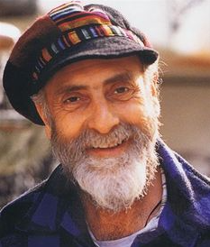
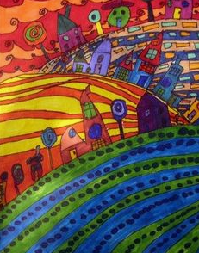
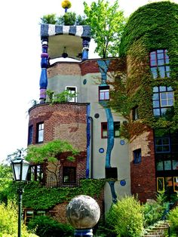
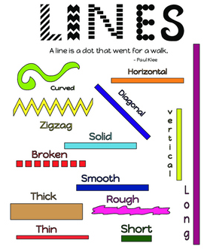
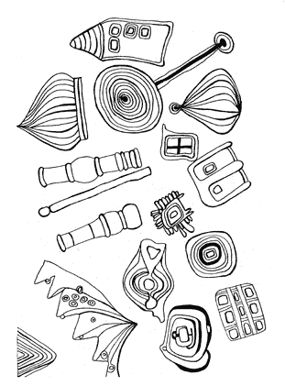

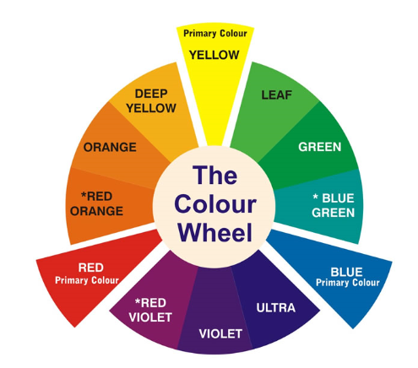

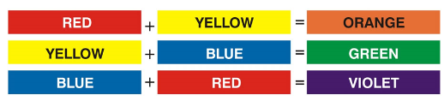
Shirley Heath Drawing: | Year 3 | Term: Summer
Friedensreich Hundertwasser
Vocabulary
1 | Architect | Someone who designs buildings
2 | Environmentalist | Someone who works to protect the natural environment
3 | Eco-activist | Someone who wants to get people involved to make changes to the environment
4 | Organic forms | Shapes coming from living things eg; waves, mountains
5 | Frame | A rim or border that encloses something eg: a picture frame
6 | Artistic vision | A strong artistic image in one's imagination
7 | Position | The position from which one views a scene without moving his or her body or eyes in
8 | Foreground | The foreground is the part of a photograph, painting, or scene that's closest to you.
9 | Background | The background is the part of a photograph, painting, or scene that's farthest away from you.
Who is he and what is he famous for?
He was an Austrian artist and architect, born 1928 - died 2000. He is also well known as an environmentalist and eco-activist. He is known for his lively imagination; his art was described as ‘unruly and chaotic’.
What inspired him?
He was inspired by nature. He and wanted humans to live in harmony with nature, where there are no straight lines. In his work he used spirals, organic forms, wavy lines, bright colours. Even his buildings fit around nature and they often have roof gardens.
Elements of Art: Shape & Line
The colour wheel
Primary Colours
Secondary Colours
from mixing primary colours together

