Slide 1
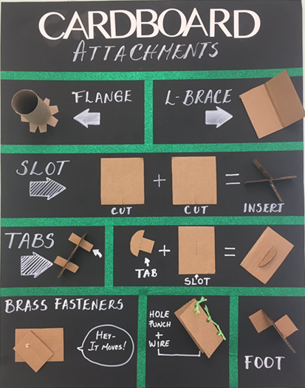
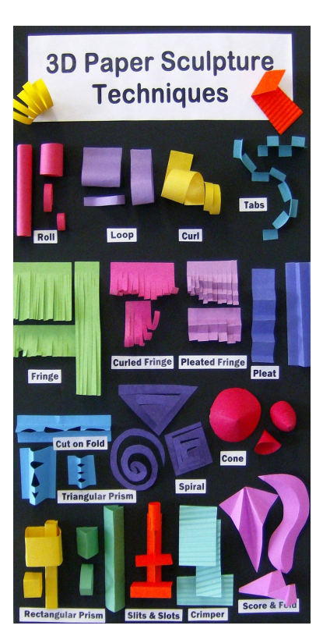
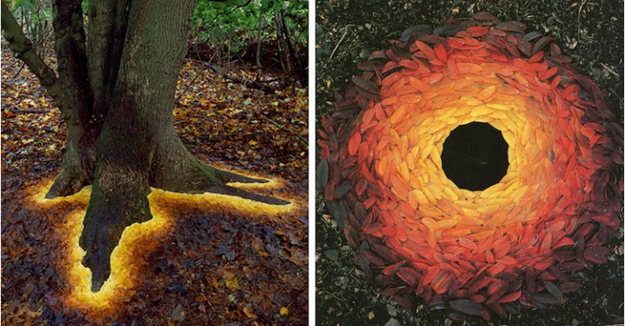
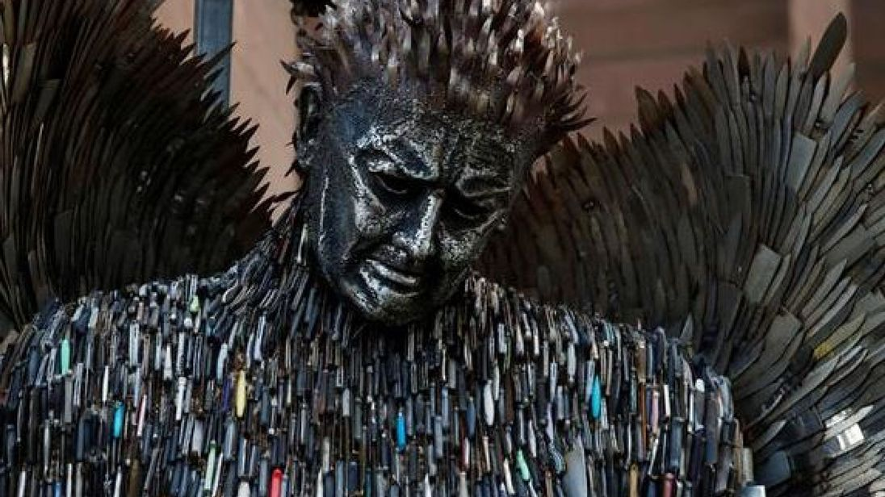
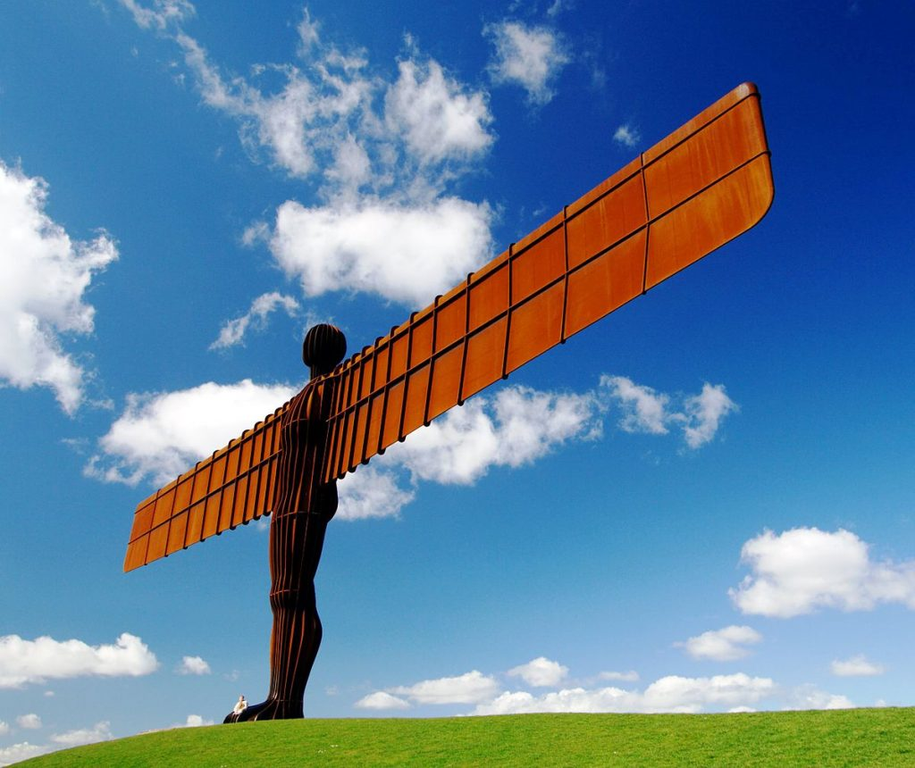
Shirley Heath Sculpting| Year 4 | Term: Summer
Attachment techniques
Paper sculpture techniques
Vocabulary
1 | Media | The substance that an artist use to make art
2 | Natural materials | Materials found in nature such as leaves, stones, seeds etc.
3 | Man made materials | Materials created by man such as plastic, metal, glass etc.
4 | Techniques | The method used to complete the art work such as painting or more focus such as blending.
5 | Process | The method used to create artwork that usually follows a range of steps rather than just one skill.
6 | Sculpture | A three dimensional piece of art work that can be created from different media.
7 | Assemble | Fit together separate parts to form an object.
8 | Construct | Build or make using appropriate materials.
9 | Texture | The feel, appearance or consistency (thickness) of a surface or a substance.
T
British sculptors
Andy Goldsworthy produces site specific land art in both urban and rural settings using only on natural objects. His work is recorded through photographs.
Alfie Bramley worked with the British Ironwork Centre to create the Knife Angel made from 100,000 knives to discourage people not to fight with knives.
Antony Gormley designed The Angel of the North which is a contemporary steel sculpture of an angel, 20 metres tall, with wings measuring 54 metres across.

