Slide 1
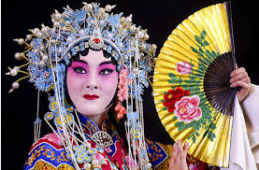
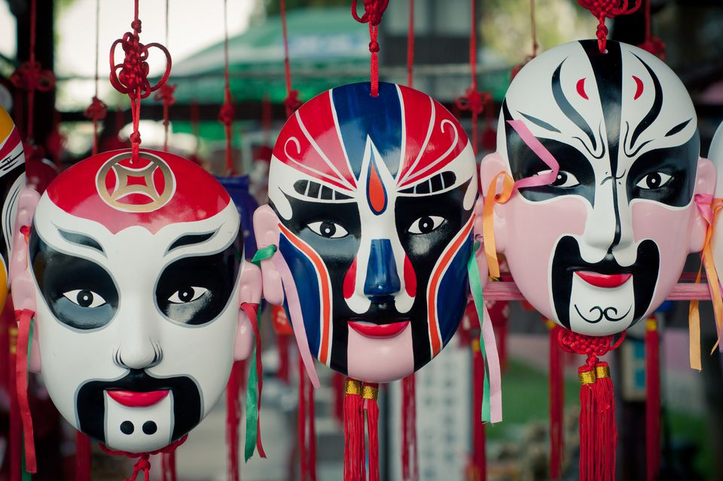
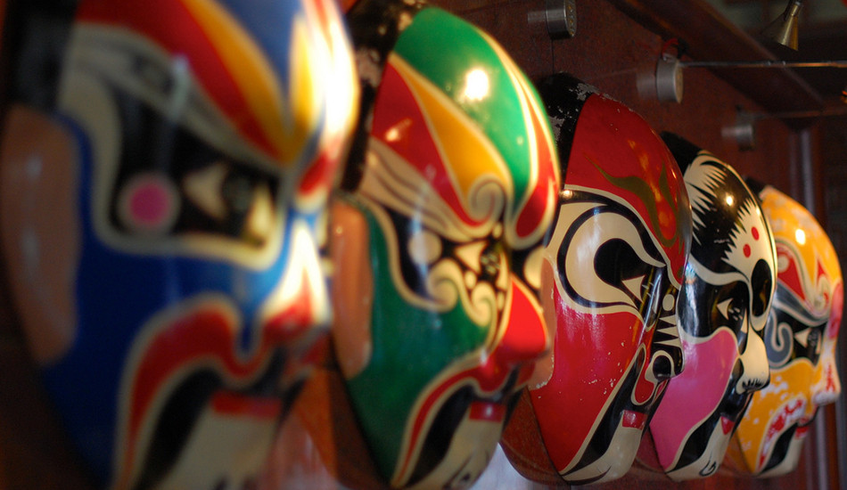
Shirley Heath Sculpting| Year 5 | Term: Summer
Chinese Opera
The meaning of colour
Vocabulary
1 | symmetry | A state in which both sides of something are balanced in size, form, or arrangement.
2 | contrast | The arrangement of opposite elements ie, light, dark, rough, smooth, small, big etc.
3 | rhythm | In art is it best described using the words pattern and repetition (a visual beat).
4 | texture | The way it feels.
5 | colour | With reference to the hue (colour), intensity (brightness), and value (lightness or darkness).
6 | modroc | A plaster bandage that is used for modelling, casting and crafting.
7 | armature | A framework around which a sculpture is built. This framework provides structure and stability, especially when a plastic material such as wax, newspaper or clay is being used as the medium.
8 | mold | A hollow form used to give a particular shape to a soft or molten substance that is poured/molded into it and allowed to harden.
Elaborately decorated with color and patterns, masks are in an important part of Chinese opera and have been for over a thousand years. Colors are used to represent personality traits and human characteristics and they connect the audience to each character’s traits quickly. The audience often feels such an instant and intimate understanding that you might even say that the colors are the characters. The dominant color gives clues about the identity of the character. Here are the meanings of some:
WHITE: Sinister, evil, crafty, treacherous, suspicious, hypocritical.
GREEN: Violent, impulsive, lacks restraint or self control.
RED: Prosperous, loyal, brave, heroic, intelligence.
BLACK: Neutral. Also indicates integrity and can mean fierceness.
YELLOW: Ambitious, fierce, intelligence. Can also be cruel, evil, or sly.
PURPLE: Represents justice and sophistication.
BLUE: Neutrality. Can also mean stubborn, astute, and fierce.
SLIVER: For a god or demon. May also be a ghost or spirit.
Chinese opera is one of the oldest known dramatic art forms worldwide. It has evolved over the dynasties but is now a grand combination of music, literature, and art; accompanied by conventional musical instruments, such as gong, flute, and Erhu. There are over 360 different types of Chinese Opera. The most famous are Peking, Cantonese, Kunqu, Xiqu and Beijing Opera.

