Slide 1
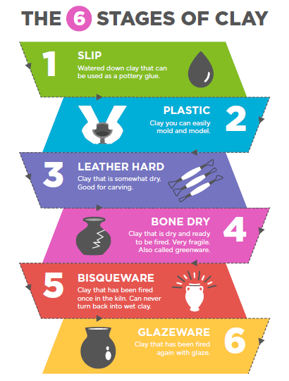
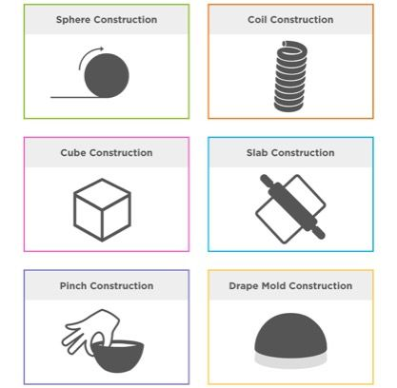
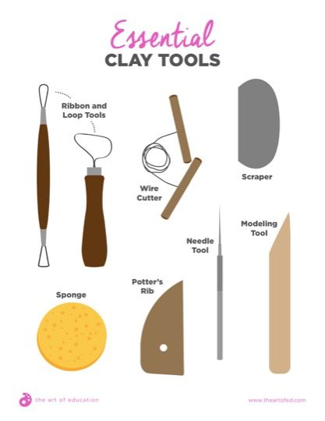
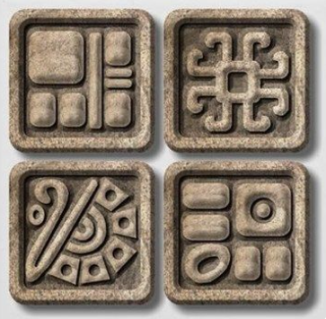
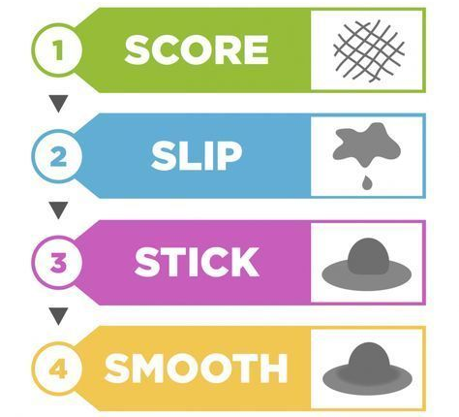
Shirley Heath Sculpting: Mayan glyph tiles | Year 6 | Term: Summer
The 6 stages of clay
Hand-building methods
Vocabulary
1 | Sculpture | 3 dimensional art form
2 | Relief | Raised surface with flat back
3 | In the round | Finished on all sides, like a statue
4 | Mobile | Has moving parts
5 | Additive | Created by joining or adding materials
6 | Subtractive | Created by carving or taking away material
7 | Positive space | Positive space refers to the main focus of a picture,
8 | Negative space | Negative space refers to the background.
SLIP
Watered down clay that can be used as a pottery glue.
PLASTIC
Clay you can easily mold and model
LEATHER HARD
Clay that is somewhat dry. Good for carving.
BONE DRY
Clay that is dry and ready to be fired. Very fragile. Also called greenware.
BISQUEWARE
Clay that has been fired once in the kiln. Can’t turn back into wet clay.
GLAZEWARE
Clay that has been fired again with glaze.
Essential clay tools
Mayan glyph tiles
How to join clay

