Slide 1





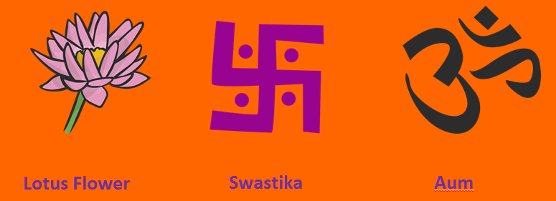
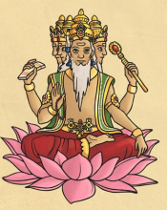
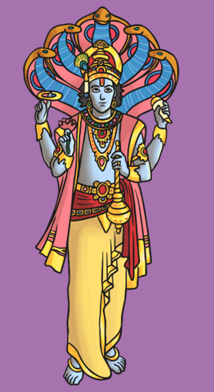
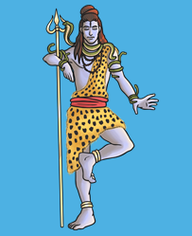
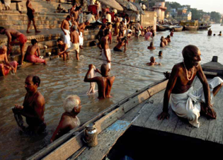
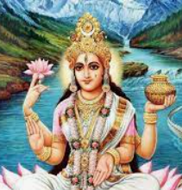
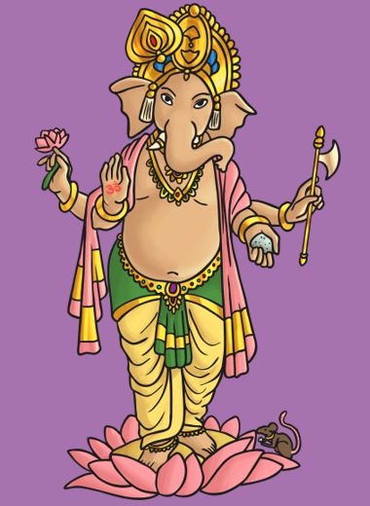
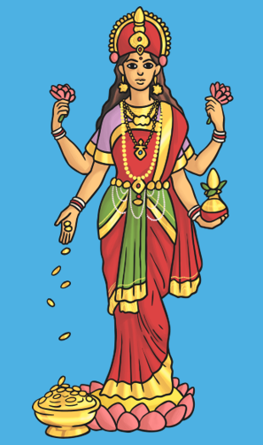
Shirley Heath Hinduism | Year 3|Spring 1 - Hinduism and The River Ganges
Puja
Hindu worship is called Puja. They pray to an image of a God either at home or in the temple. These are the different objects for the puja.
Vocabulary (Gods and Goddesses)
Brahman | A universal God that hindus believe takes on different forms.
Brahma | He is the creator of the universe and all knowledge.
Vishnu | The God who preserves the universe and people.
Shiva | He is the destroyer of the universe so that new life can come again.
Ganesh | The elephant living God and lord of all living things. He helps people overcome their problems.
Lakshmi | The Goddess of wealth and success.
Vocabulary (symbols)
Aum | The most important symbol in Hinduism. It represents the atman (soul) and Brahman (ultimate reality)
Swastika | A very holy symbol representing the sun God Surya.
Lotus Flower | An important symbol – Hindus believe that Brahma (the creator) came from a lotus flower.
Diva lamp
bell
incense
Kum kum
powder
water
River Ganges
Hindus from all over the world can go on a pilgrimage to the river to cleanse their souls. Hindus believe that Ganga - the Goddess of the river came to earth to form the river. Non Hindu tourists also visit the river.
Other Gods
Brahma the creator
Vishnu the
preserver
Shiva the
destroyer
Ganga
Ganesh
Lakshmi

