Slide 1
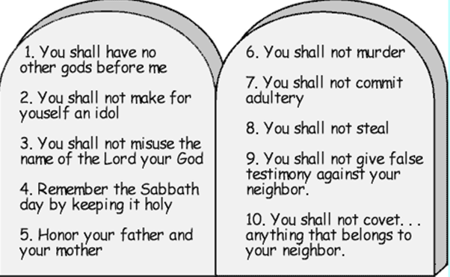
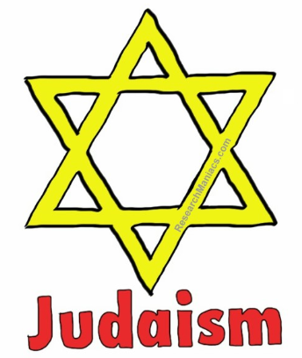
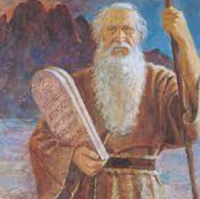
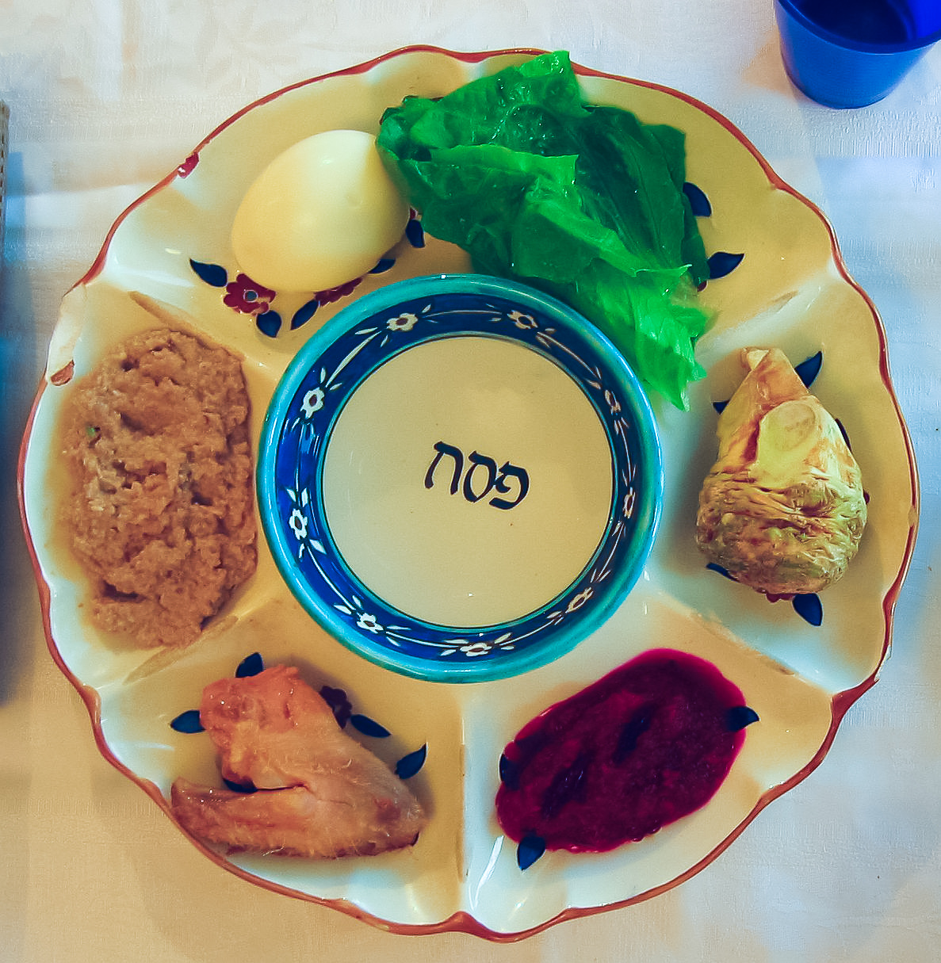
Shirley Heath Passover (Judaism) | Year 4 | Spring 1
We are learning to understand how by celebrating Passover and keeping Kashrut (food laws) Jewish people are doing what God has asked them to do.
The ten commandments
Knowledge/Vocabulary
Passover | Pesach in Hebrew is an important festival during the Jewish year. It tells the story of the Israelites’ departure from ancient Egypt.
Kashrut/kosher | This is a set of dietary laws dealing with the foods that Jews are not allowed to eat. Kashrut/kosher means fit or proper.
Seder plate | This is a special plate containing symbolic foods eaten at Passover.
The 10 commandments | These are a set of rules written by God and given to Moses on Mount Sinai. Jewish people live by these rules.
Moses | Moses was a prophet who led the Jewish people out of Egypt.
Forbidden | Not allowed or banned.
Jewish people are not allowed to eat pork or shellfish.
Meat and diary can not be eaten together.
Meat must be killed in a special way and salt added to remove blood. This is called Kashrut or kosher.
Moses
Seder plate
There are 5 foods that go
on the seder plate. These are
a shank bone
an egg
bitter herbs
Vegetables in a sweet paste
more bitter herbs

