Slide 1

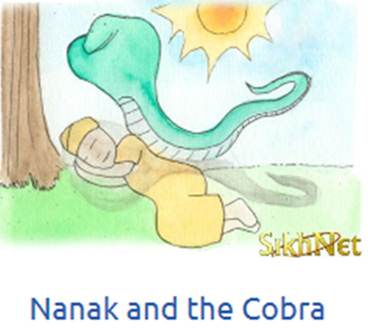
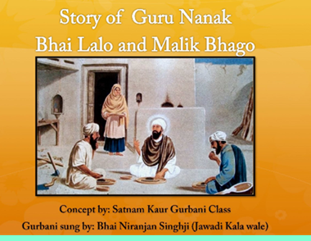
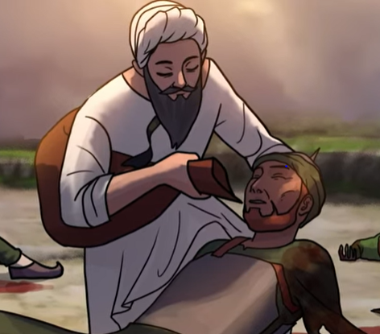
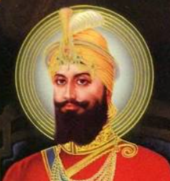
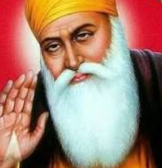

Shirley Heath Sikhism | Year 5|Spring 1
You will learn the meanings of different Sikh stories and learn their relevance to Sikhs and non-Sikhs in society today.
Knowledge (stories)
Guru Nanak and the jasmine flower. | This story teaches that everyone is equal in God’s eyes. It is important to be tolerant of others and accept their views. There is room for everyone in the world.
Bhai Lalo and Malik Bhago | This is a story about equality and honesty. It teaches us to care for others and not to judge people because they are poor.
Bhai Kanhaiya Singh | This story teaches the importance showing compassion to others in a crisis.
Vaishaki birth of the khalsa | This story is about courage and standing up for what you believe in.
Vocabulary
Guru Nanak | The founder of Sikhism. The first of the 10 Sikh Gurus.
Khalsa | The khalsa is a key event in the history of Sikhism. It was formed in 1699 by Guru Gobind Singh.
Guru | Means teacher it’s used in Sikhism to refer to the ten human Gurus and the Guru Granth Sahib
Guru Granth Sahib | Sikh holy book.
Compassion | Concern for the suffering of others
Crisis | A time of difficulty or danger
Respect | To accept somebody for who they are.
Guru Nanak and the
jasmine flower
Guru Gobind Singh
Guru Nanak
The Khanda is a
symbol of the Sikh faith.

