Slide 1

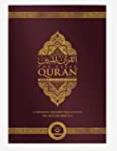
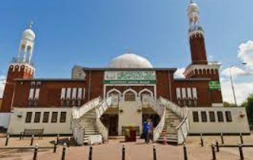
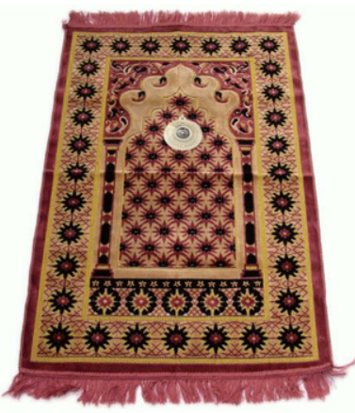

Islam | Year 6| Autumn 1 What is the best way for a Muslim show commitment to God?
We are learning to understand some of the ways Muslims show commitment to God and to evaluate whether there is a best way.
Knowledge
 | Muslims must show their commitment to God in different ways. They follow the 5 pillars of Islam. These are: Shahada A declaration of their faith. They believe there is only one God which is Allah. Salah This pillar is a prayer – Muslims pray 5 times a day. They use a prayer matt Zakat This pillar is looking after other people. Giving money to charity Sawm This pillar is Ramadam where muslims fast for 30 days during sunlight. Hajj All Muslims have a duty to go on a pilgrimage to Makka at least once in their life
Vocabulary
Commitment | You show commitment by doing something on a regular basis and by demonstrating loyalty, hard work and belief
Ramadam | Ramadam is the ninth month of the Islamic calendar. It is a month of fasting, prayer and reflection.
Mosque | A mosque is the Muslim place of worship. There is a dome at the top. The tower is called a minaret. The wall called the qiblah faces east to face Makka.
Allah (Muslim name for God) | Muslims show Allah that he is the most important thing in their lives. Allah wants commitment from all Muslims.
Qur’an | Muslim holy book written in Arabic. Muslims try to learn this by heart so they know the message.
Charity | The voluntary giving of help to those in need. Muslims who can will give 2.5% of their yearly savings to charity.
Purify | To make something clean.
The 5 pillars of Islam are the core
beliefs and practices of Islam.
The Qur’an is
the holy book
Prayer mat
Place of worship - Mosque

