Slide 1
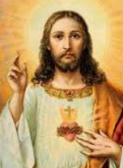
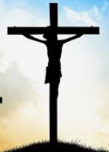
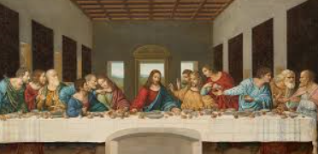
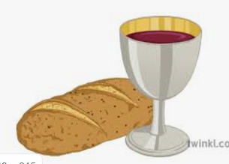
Shirley Heath Easter (Christianity) | Year 3|Spring 2
What was good about Good Friday?
Knowledge
Christians believe that Easter is the most important Christian festival. It celebrates Jesus coming back to life. Christians celebrate Easter in March or April. They remember when Jesus died on the cross and rose again. Jesus’ death was part of God’s plan to show people they can be forgiven and start afresh. Christians believe God made a beautiful world, but when people started forgetting how to be good, God sent Jesus to make things better, to save the day. This meant forgiving people for what they had done wrong. Christians believe that Jesus went willingly to his death because he trusted God as his father.
Vocabulary
Crucifixion | Being put to death by being nailed to a cross. This was a common punishment for certain crimes in Jesus’ times.
Holy week | The week of events leading up to the death of Jesus including
Palm Sunday | This is the Sunday before Easter. It is when Jesus entered Jerusalem on a donkey and the people welcomed him by waving palm leaves.
The last supper (Maundy Thursday) | Jesus ate the last supper with his disciple. He washed their feet.
Good Friday | The day that Jesus was nailed the cross to die.
Easter | The day that Jesus rose from the dead. This is the day that Christians celebrate Easter.
Disciples | Jesus’ special friends.
Communion Bread/wine | Jesus gave bread as a symbol of his body and wine to represent his blood. Christians have holy communion in church.
Incarnation | God becoming man.
Jesus
The crucifixion
The Last Supper
Holy communion

