Slide 1
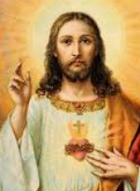


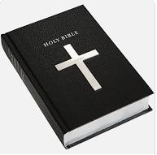
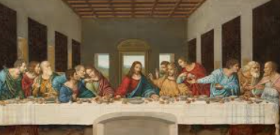
Shirley Heath Easter (Christianity) | Year 4|Spring 2
Is forgiveness always possible for Christians?
Vocabulary
Forgiveness | Is no longer feeling angry or wanting to punish someone for making a mistake
Last Supper | This is the last meal that Jesus shared with his disciples before he was put on the cross to die.
betrayal | Is when a person’s actions hurt or disappoint someone who they love. They are disloyal.
Judas | One of Jesus’ disciples. He made the soldiers know who Jesus was by kissing him. Then Jesus was arrested.
Biblical texts | Readings from the bible that show the Christian understanding of forgiveness.
Gospel | The first 4 books of the New Testament about Jesus’ life, teachings and death.
The Lord’s prayer | A Christian prayer which Jesus taught as the way to pray.
Incarnation | God becoming man.
Disciples | Jesus’ 12 special friends.
Knowledge
Christians believe that Easter is the most important Christian festival. It celebrates Jesus coming back to life. Christians celebrate Easter in March or April. They remember when Jesus died on the cross and rose again. Christians believe that Jesus’ death offers them forgiveness from God and that with his help they can do their best to forgive other people. They believe that Jesus’ death took away their ‘sins’ and offered forgiveness and salvation. Jesus forgave the people who let him down.
The crucifixion
Jesus is the son
of God
The Lord’s Prayer
The bible is the Christian holy book. There are are many text in the bible about forgiveness
Many Christians will be know of and may say “The Lord’s Prayer”. The Christian asks God to forgive his or her wrongdoing as they forgive people who have wronged them.
The Last
Supper

