Slide 1
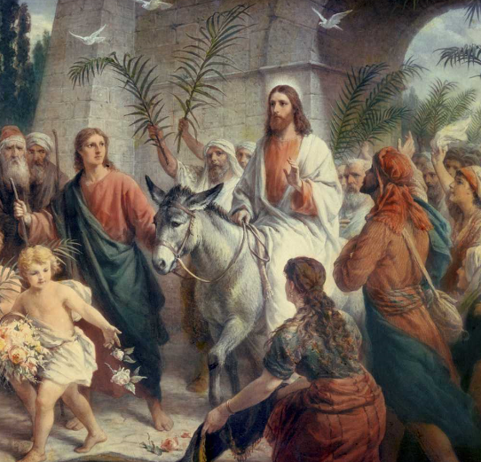
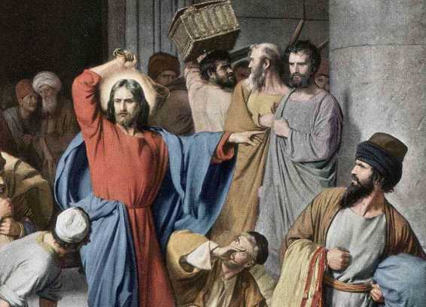
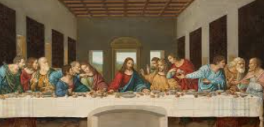

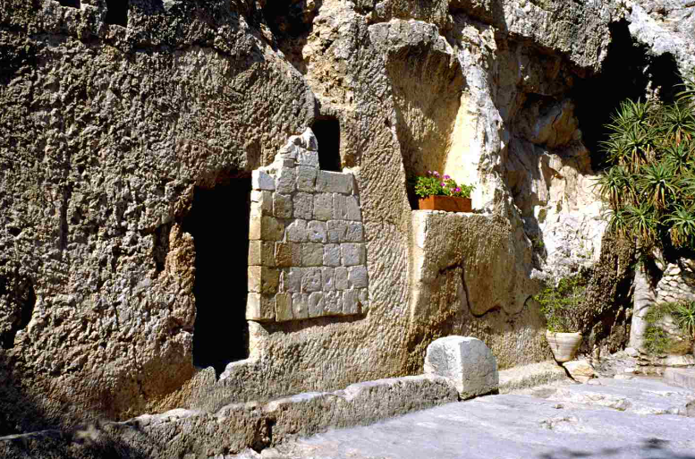
Shirley Heath Easter (Christianity) | Year 5|Spring 2
Jesus entering
Jerusalem on
a donkey
We are learning to question whether God intended Jesus to be crucified or whether Jesus’ crucifixion was the consequence of events during Holy Week.
Knowledge
Easter is celebrated in March or April. Christians remember when Jesus was crucified and was resurrected. Christians believe that Jesus is the son of God, who came to Earth in order to save humans from their sins. His death and resurrection opened up the way back to God and restored humanity’s relationship with him. This is the Christian concept of salvation Holy Week Palm Sunday – The Sunday before Easter. It is when Jesus arrived in Jerusalem on a donkey and the crowd waved palm leaves. Monday - Jesus cleared the temple of all the people selling because he said that the temple should just be for praying. Maundy Thursday – The Thursday before Easter. It is when Jesus ate the last supper with his disciples and he washed their feet. Good Friday – Jesus was crucified and died on the cross. Easter Sunday – The tomb was empty – Jesus had risen from the dead.
Vocabulary
Resurrection | This is when a dead person comes back to life.
Crucifixion | This is where a person is nailed to a cross and left to die.
Betrayal | Is when a person’s actions hurt or disappoint someone who they love. They are disloyal. Judas betrayed Jesus.
Judas | Judas was one of Jesus’ disciples he made the soldiers aware of who Jesus was by kissing him. This lead to Jesus being arrested.
Incarnation | The belief that Jesus Christ is God in human form.
Purpose | The reason for which something is done or why something exists.
Destiny/goal | A plan for someone’s life which they have little or no control over.
Sacrifice | This is a loss or something you give up, usually for the sake of a better cause.
Traders in the temple.
The Last Supper
The empty tomb
The crucifixion

