Slide 1



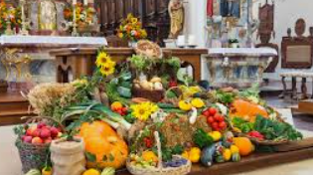
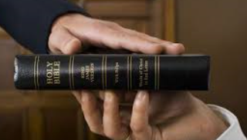
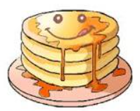
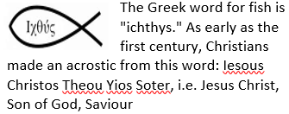
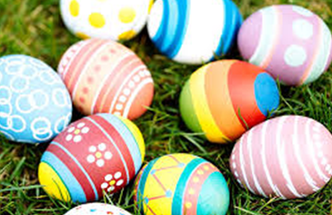
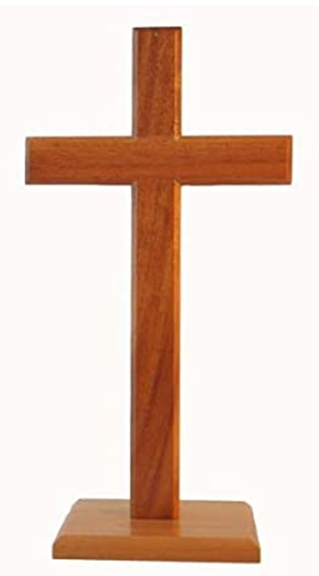
(Christianity) | Year 6|Spring 2
Is Christianity still a strong religion 2000 years after Jesus was on earth?
Knowledge
This enquiry draws on all previous learning about the concepts of Christianity Other Christian festivals: Lent – The 40 days leading up to Holy week to remember Jesus’s time fasting in the desert. Shrove Tuesday - People celebrate by eating pancakes Ash Wednesday – A Christian holy day of prayer and fasting and is the start of Lent. Mothers’ Day – A Christian celebration honoring the mother of the family. Harvest – A time when crops are ripe and ready to be gathered. Advent – The preparation time for Christmas
Vocabulary
Influential | A thing or person that has power to effect you in a good or bad way.
Sensitivity | Being easily upset or hurt by things that people say or do.
Persecution | To treat someone cruelly or unfairly because of their race or their religious or political beliefs.
Resurrection | Coming back to life after death.
Incarnation | The belief that Jesus Christ is God in Human form and then to die as a sacrifice so they could be forgiven and come back to life again to prove to Christians that they could also have life after death
Salvation | God sent Jesus to earth to die and to be resurrected to allow man to have a pathway back to God where he can live with God for eternity.
Charity | An organisation set up to provide help and raise money for those in need. These charities demonstrate loving thy neighbour.
poverty | This is not having enough money for basic needs like food, clothing and shelter.
Festival | A gathering of people to celebrate something special. This is usually for religious reasons.
Harvest
The crucifixion
Shrove
Tuesday
Swearing on oath
Christian symbols
The cross represents
Jesus’ death and
resurrection
Easter eggs represent new
life and Jesus’ resurrection

