Slide 1
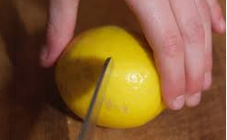
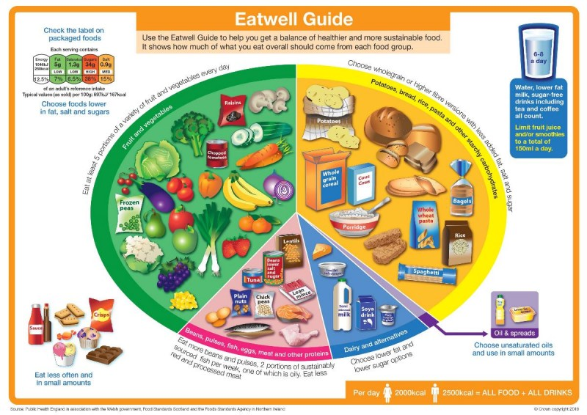
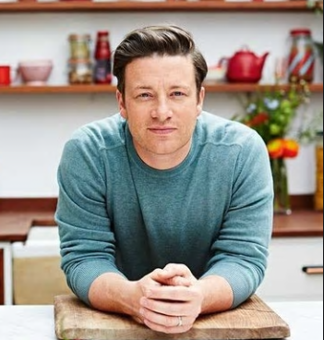
Shirley Heath Fruit Salad and Pizza Toppings| Year 3 | Spring 2
KEY QUESTION
Some children can go all day without eating any fruit or vegetables! It is recommended that we have at least 5 portions of fruit and vegetables each day… How can we get more fruit and vegetables into our meals?
KNIFE SKILLS
BRIDGE HOLD Create a bridge over the food with your hand. The fingers should be on one side and the thumb should be on the other. Hold the food to be cut between the fingers and thumb creating a bridge. The knife should go through the bridge to cut the food. | This method ensures that fingers are out of the way as the knife cuts through the food.
VOCABULARY
Locally sourced | Food or ingredients which have been grown, reared or caught nearby
Internationally sourced | Food or ingredients which have been grown, reared or caught in a different country around the world
Climate | The general weather conditions of an area over a long period of time
Seasonal | Expected weather at different times of the year
Reared | To bring up and care for (an animal) until it is grown
Grown | Relating to plants
Caught | Captured from the sea
Farmed | An ingredient which is grown on a farm before being created into a food item
KEY PERSON
JAMIE OLIVER
Jamie Oliver was born on 27th May 1975. He is a British chef who is well known for his approachable cuisine, which has led him to front numerous television shows. In 2005 he opened a campaign, Feed Me Better, to introduce schoolchildren to healthier foods, which was later backed by the government. Jamie wants people to lead healthier lifestyles.
THE EATWELL PLATE
Above is a picture of the ‘Eatwell Plate’. You will learn that this plate is separated into different food groups. We need to eat a balanced diet which means eating from each section of the plate

