Slide 1
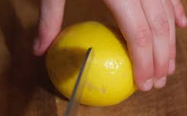
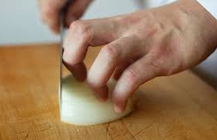
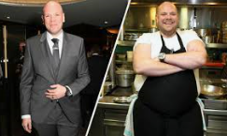
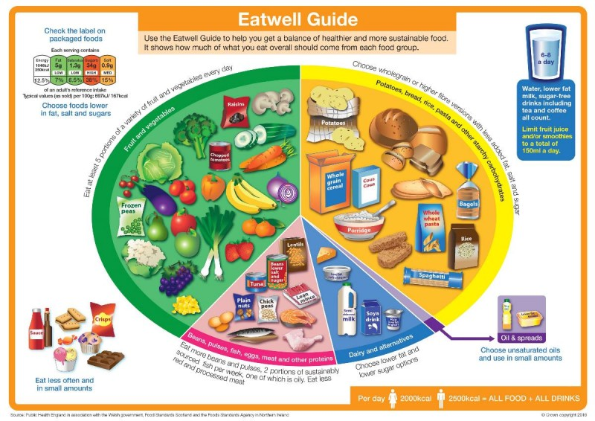
Shirley Heath Rainbow Couscous and Fruity Picnic Bars | Year 4 | Summer 1
KEY QUESTION
Food costs a lot of money to buy. Some foods are different prices at different times of the year. Why is this? Can we help our parents save money by working out what foods to buy at which time of the year?
KNIFE SKILLS
BRIDGE HOLD Create a bridge over the food with your hand. The fingers should be on one side and the thumb should be on the other. Hold the food to be cut between the fingers and thumb creating a bridge. The knife should go through the bridge to cut the food. | This method ensures that fingers are out of the way as the knife cuts through the food.
CLAW GRIP Create a claw by partly curling your fingers together into a claw shape. Press the tips of your fingers (nails) against the food to be gripped and then lean your fingers slightly forward of your nails so that you can’t see your nails when you look down on your hand. | This method ensures that finger tips are tucked out of the way and will not get caught by the knife.
HEALTHY EATING
Carbohydrates | - Gives the body energy - 1/3 of your diet - Potatoes, pasta, rice, etc.
Vitamins and Minerals | Help our bodies to work properly (eg. eyes, skin, organs) 1/3 of your diet
Protein | Repairs muscles 1/6 of your diet Meat, fish, beans, etc.
Fats | Gives the body energy but also helps to absorb some vitamins Should be eaten sparingly
Dairy | Keep bones healthy Around 2 portions a day Milk, yogurt, cheese, etc.
KEY PERSON
TOM KERRIDGE
Thomas Kerridge is an English Michelin-starred chef who has worked mainly in the United Kingdom. He decided to attend culinary school at the age of 18. As a chef he has appeared on the Great British Menu, MasterChef and Saturday Kitchen and more recently fronted his own series How to Lose Weight For Good.
THE EATWELL PLATE
The Eatwell Plate is designed to make healthy eating easier. Eat foods from each group on The Eatwell Plate in the correct amounts each day. This way, you'll get the balance of energy and nutrients you need for good health. Foods that are like each other sit together in the same group and can be swapped.

