Slide 1
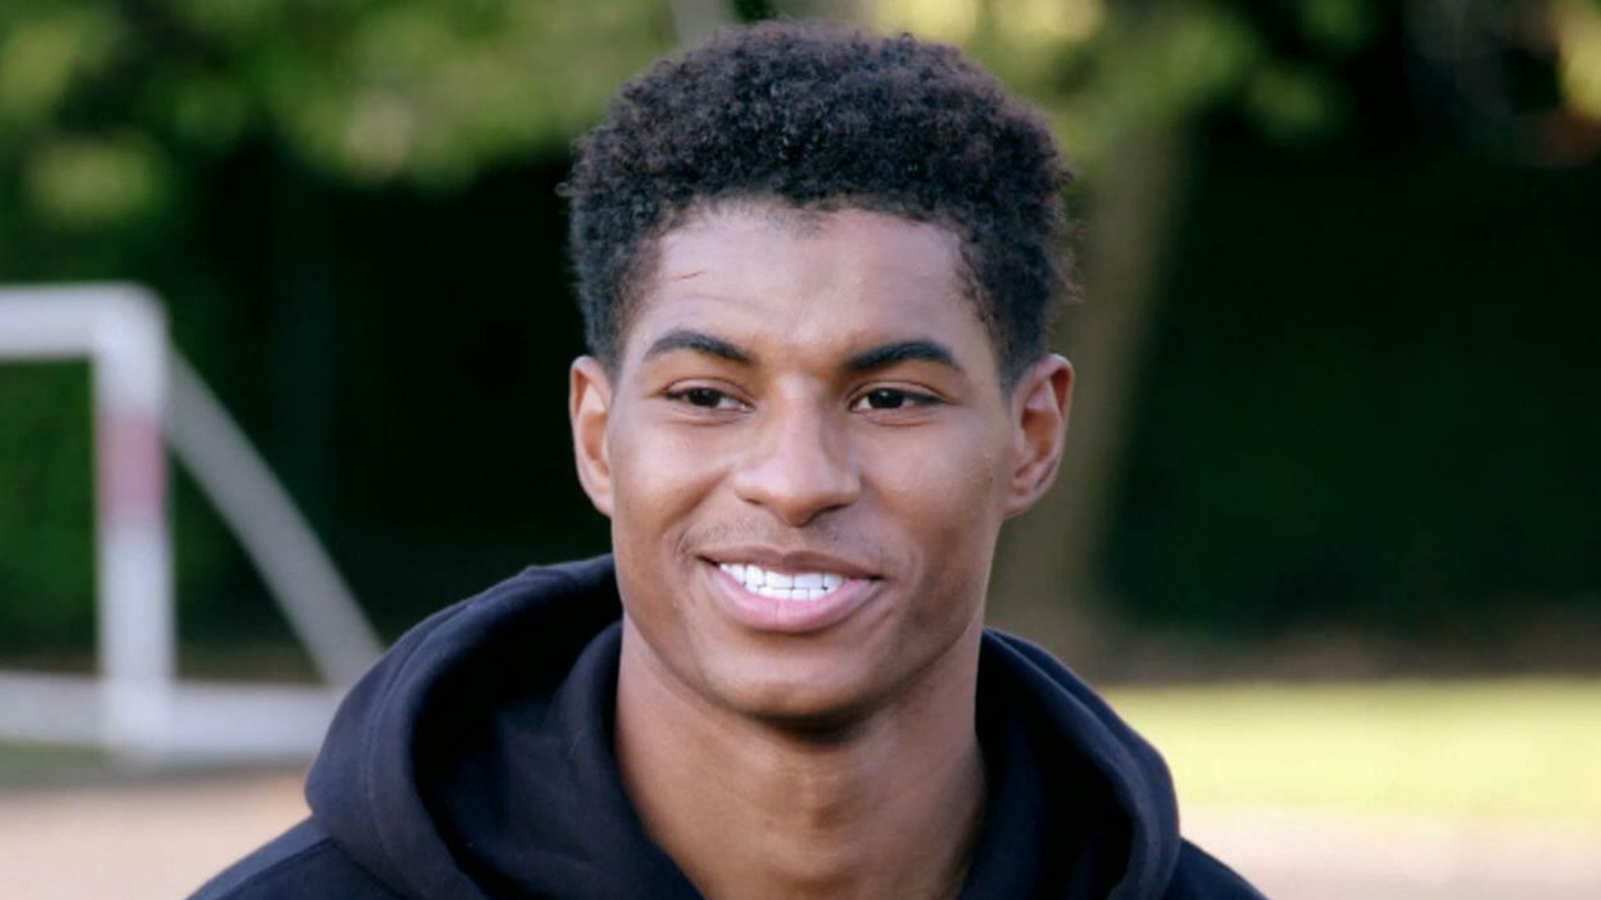
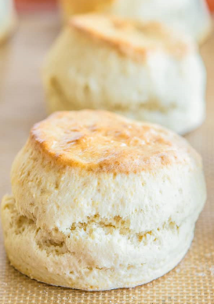
Shirley Heath Baking Scones | Year 5 | Spring 1
KEY QUESTION
Children are becoming more and more unhealthy because they snack too much on the wrong type of foods. How can we help children understand what they need to eat to have a healthy balanced lifestyle?
THE EATWELL PLATE
The Eatwell plate is a pictorial food guide showing the proportion and types of foods that are needed to make up a healthy, varied and balanced diet.
Fruit and vegetables They should make up over a third of the food we eat each day. Aim to eat at least 5 different portions of fruit and veg each day. Remember that fruit juice and smoothies should be limited to no more than a combined total of 150ml a day.
Carbohydrate Starchy food should make up just over a third of the food we eat. Choose higher fibre wholegrain varieties, such as wholewheat pasta and brown rice, or simply leave skins on potatoes. Starchy foods are a good source of energy and the main source of a range of nutrients in our diet.
Dairy and Dairy alternatives Milk, cheese and fromage frais are good sources of protein and some vitamins, and they're also an important source of calcium, which helps keep our bones strong. You can also have dairy alternatives, such as soya milk an yoghurts.
Protein Pulses, such as beans, peas and lentils, are good alternatives to meat because they're lower in fat and higher in fibre and protein, too. Choose lean cuts of meat and mince, and eat less red and processed meat like bacon, ham and sausages. Aim for at least 2 portions of fish every week, 1 of which should be oily, such as salmon or mackerel.
Oils and spreads Unsaturated fats are healthier fats and include vegetable, rapeseed, olive and sunflower oils. Remember all types of fat are high in energy and should be eaten sparingly.
Foods high in Sugar, Salt or Fat These foods include chocolate, cakes, biscuits, sugary soft drinks, butter, ghee and ice cream. They're not needed in our diet, so should be eaten less often and in smaller amounts.
COOKING TECHNIQUES
Mix | Use a wooden or metal spoon to carefully mix all ingredients together in a bowl, usually by stirring. Mix in a circular motion.
Rub | Use your fingertips to rub the fat in to the flour. It helps if the fat is cold. Continue until it is all combined.
Measure | Use a measuring spoon for small amounts or a measuring jug for larger amounts of liquid. Measure using scales
Roll | Put your hands on either end of the rolling pin and roll until your dough is the correct thickness all over.
Grease | Smear a small amount of fat, such as margarine, all over the inside of the tin you are cooking in so it does not stick.
Knead | To work and press dough with the palms of the hands or mechanically, to develop the gluten in the flour.
KEY PERSON
MARCUS RASHFORD
Marcus Rashford, an English football player born in 1997, championed a campaign during the COVID-19 school closured to extend the free school meal voucher scheme which the government were set to discontinue. Rashford’s campaign meant that families living on or below the poverty line in the U.K. were able to access funds to enable them to feed their children healthy and nutritious meals.

