Slide 1
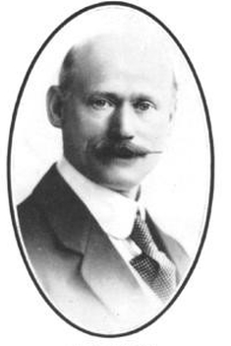

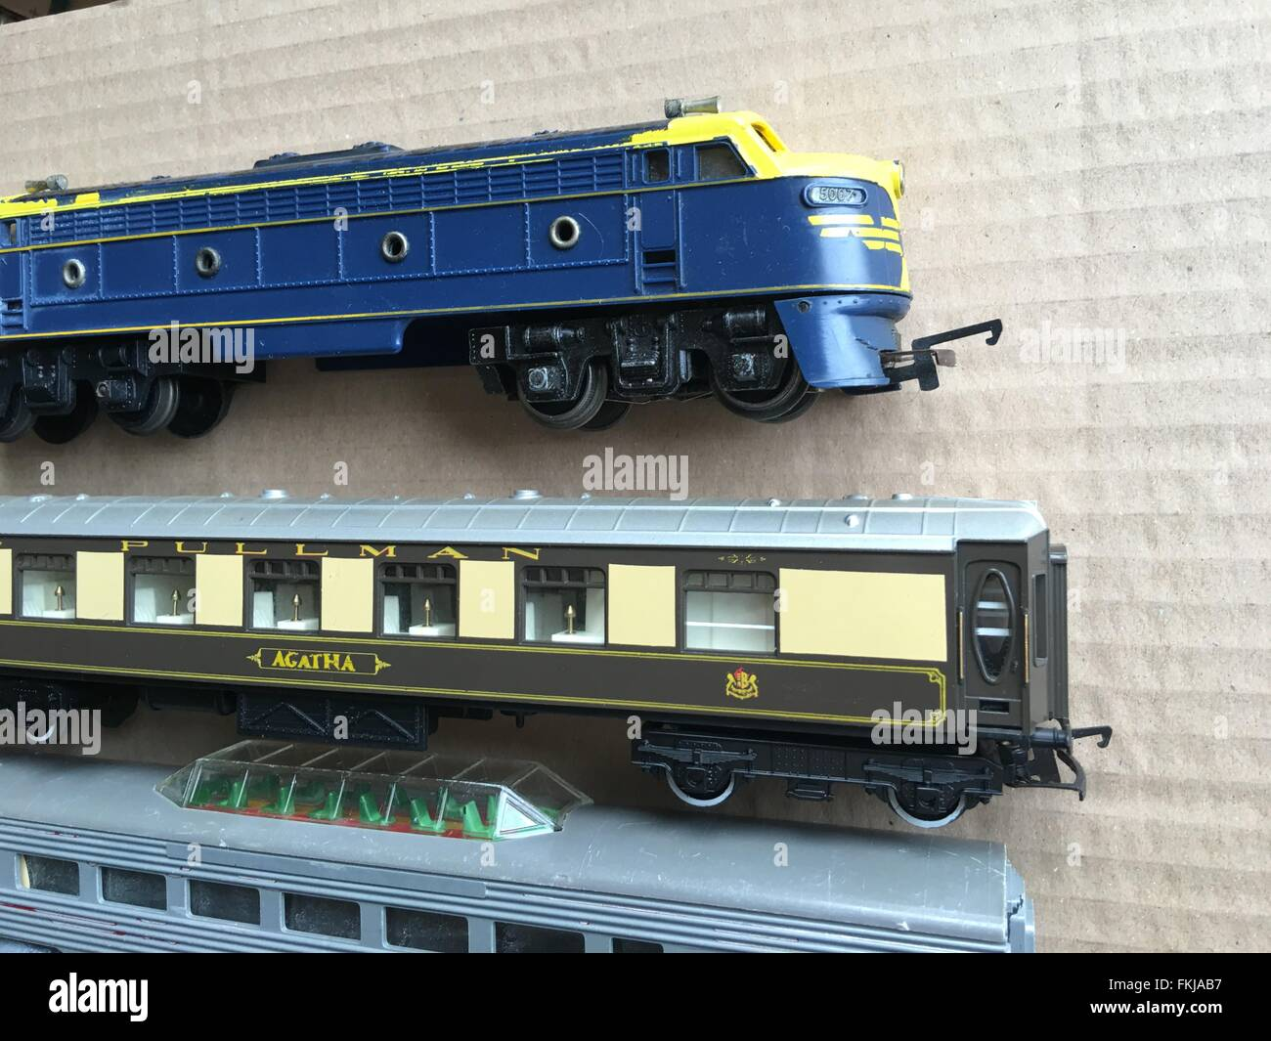

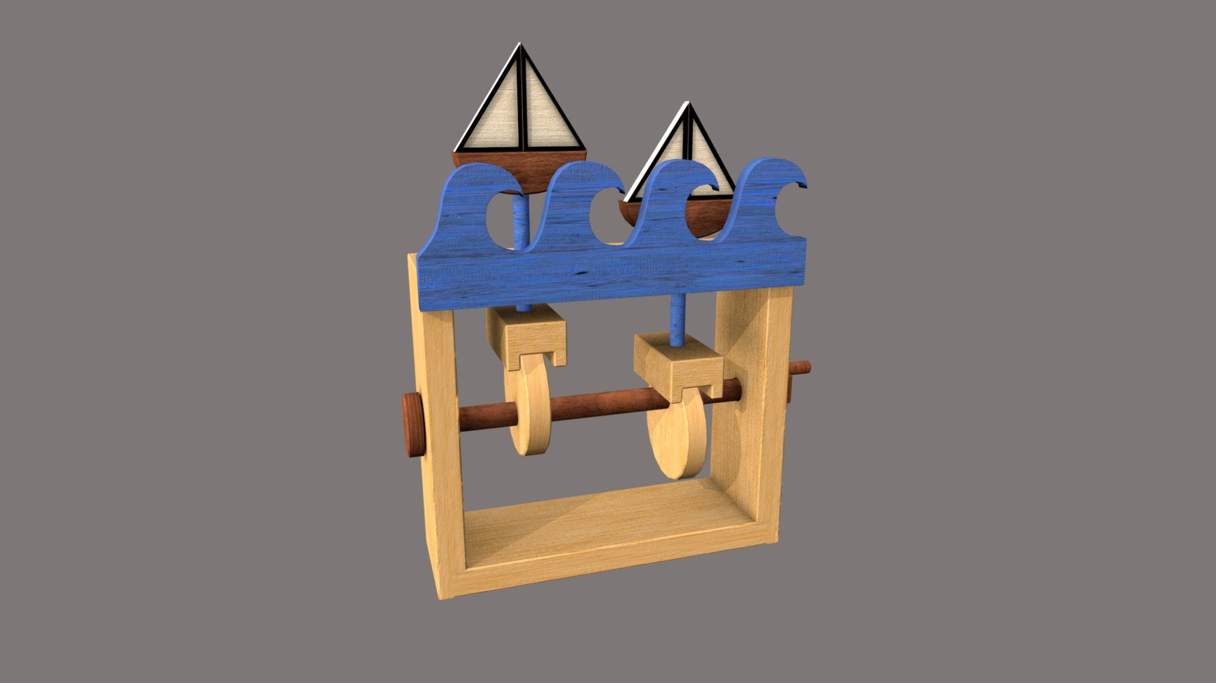
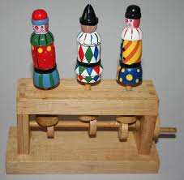
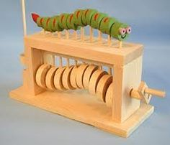
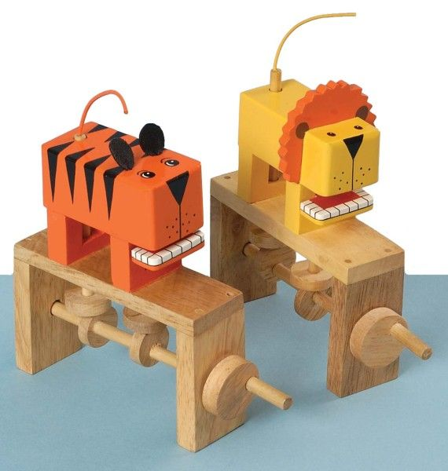
Shirley Heath Moving Toys| Year 6 | Spring Term
KEY INDIVIDUAL FRANK HORNBY
 | Frank Hornby (15 May 1863 – 21 September 1936) was an English inventor, businessman and politician. He was a visionary in toy development and manufacture, and although he had no formal engineering training, he was responsible for the invention and production of three of the most popular lines of toys based on engineering principles in the 20th century: Meccano, Hornby Model Railways and Dinky Toys.
KEY VOCABULARY
Linear motion | Up and down movement
Rotary motion | Movement that turns in a circle
Mechanism | All the different parts that work together in a machine
Cam | A mechanism that changes rotary movement into linear movement, depending on the shape of the cam
DESIGN BRIEF
With the rise in popularity of online games and consoles, Mrs Evans has challenged the Year 6 children to design a traditional, moving toy which can be used by children of all ages. The toy will need include a cam mechanism and a child-friendly design.
KEY KNOWLEDGE
A cam is a rotating or sliding piece in a mechanical linkage used especially in transforming rotary motion into linear motion. It is often a part of a rotating wheel or shaft that strikes a lever at one or more points on its circular path. A movement made by different shaped cams (off-centre circle, egg and snail). A cam mechanism has two main parts: a cam - attached to a crankshaft, which rotates. A follower - touches the cam and follows the shape, moving up and down. Snail or drop cams have the appearance of a snail shell. It causes the follower to remain stationary for half a turn before gently rising and suddenly falling.

